Slide 1
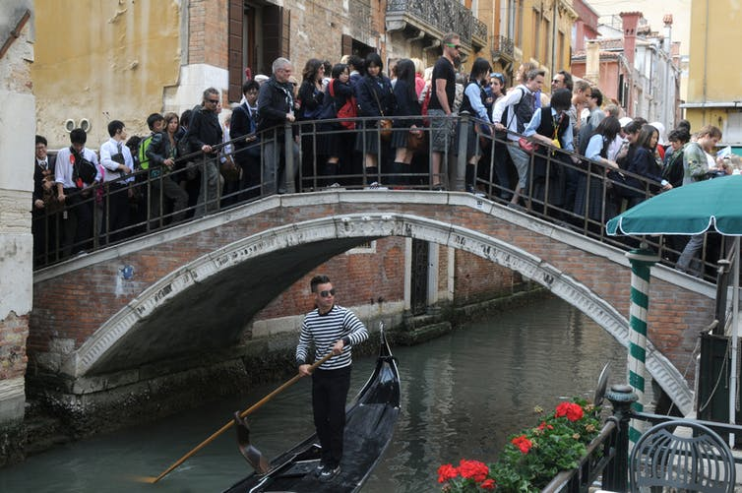
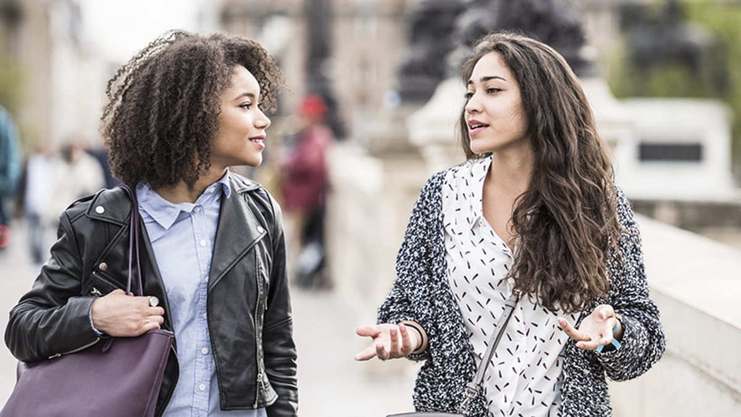
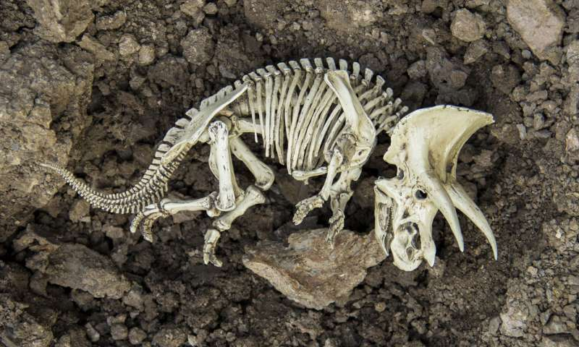
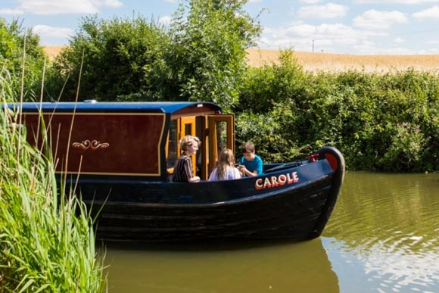
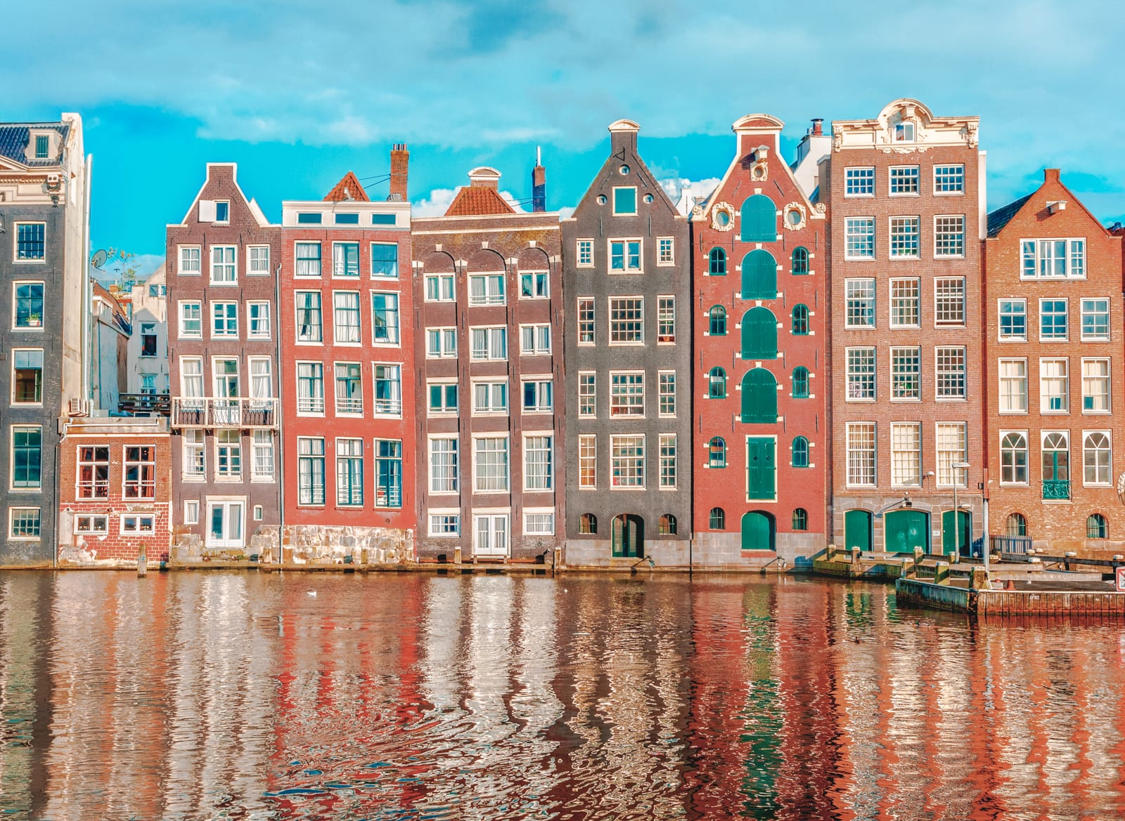
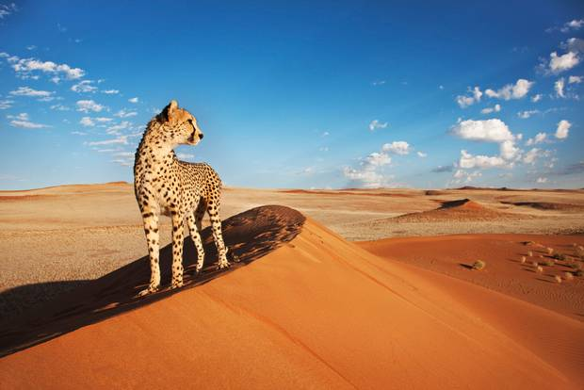
POSSIBLE FINAL MAJOR PROJECT THEMES
OVERTOURISM
ACCENTS
EXTINCTION
CANAL BOATS
HOLLAND
NAMIBIA

Slide 2
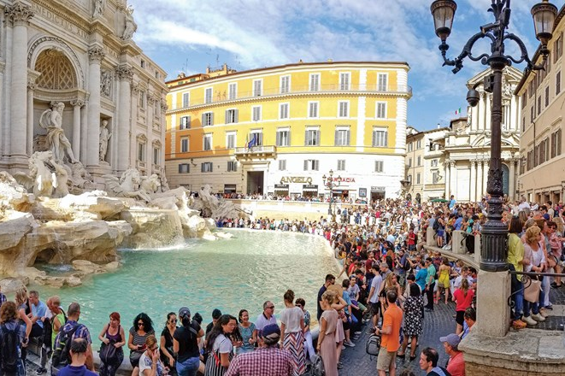
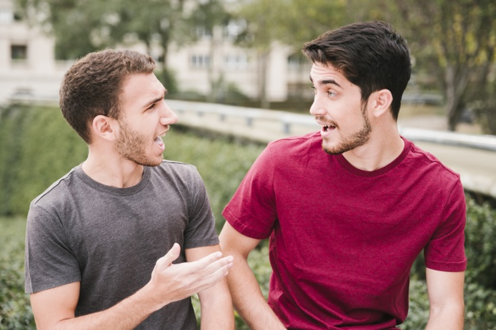
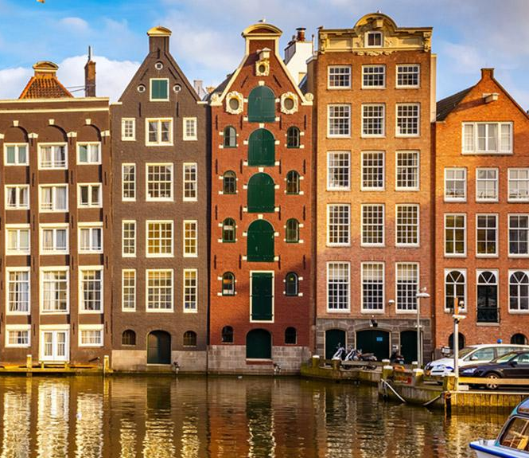
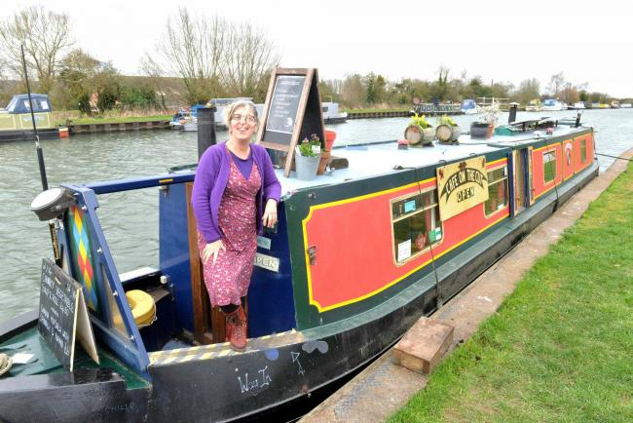
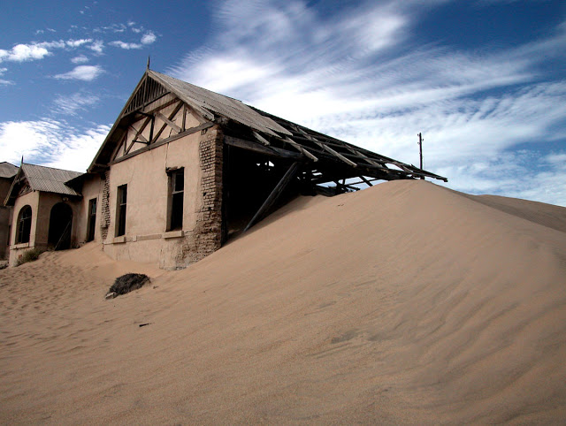
POSSIBLE
TOPIC IDEAS
Overtourism
What it is
How to prevent it getting worse
Venice
Accents
How they come about
New Accents
Slang
English Accents
The Netherlands
Rising Sea levels
Gouda
Narrow Canal Houses
Cycling flat roads
Change In Name
Canal Boats
Live-a-board Life
Culture
How they get basic needs
Risk of loosing their freedom
Namibia
Diamond Industry
Sand Surfers
Saving the Rhinos
Living In a Desert

Slide 3
THE NETHERLANDS VARIOUS TOPICS
TOPIC | HAS IT BEEN DONE? | WHERE WOULD I FILM? | HOW LONG WOULD IT BE? | RATED OUT OF 10
Rising Sea levels | Yes, loads of times | Everywhere | 20m | 7/10
Gouda | Yes, several times | Gouda Factory | 15m | 3/10
Narrow Canal Houses | Yes, a couple of times | Amsterdam | 8m | 6/10
Cycling flat roads | Yes, loads of times | Amsterdam, anywhere | 10m | 8/10
Foreigners In Amsterdam | Once | Amsterdam | 15m | 5/10
Change In Name | Not a documentary | Amsterdam, anywhere | 10m | 6/10

Slide 4
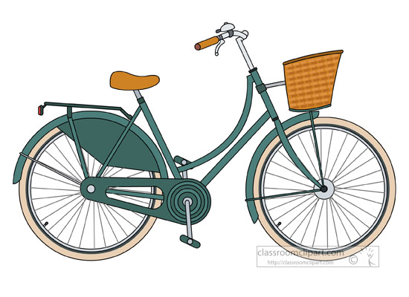
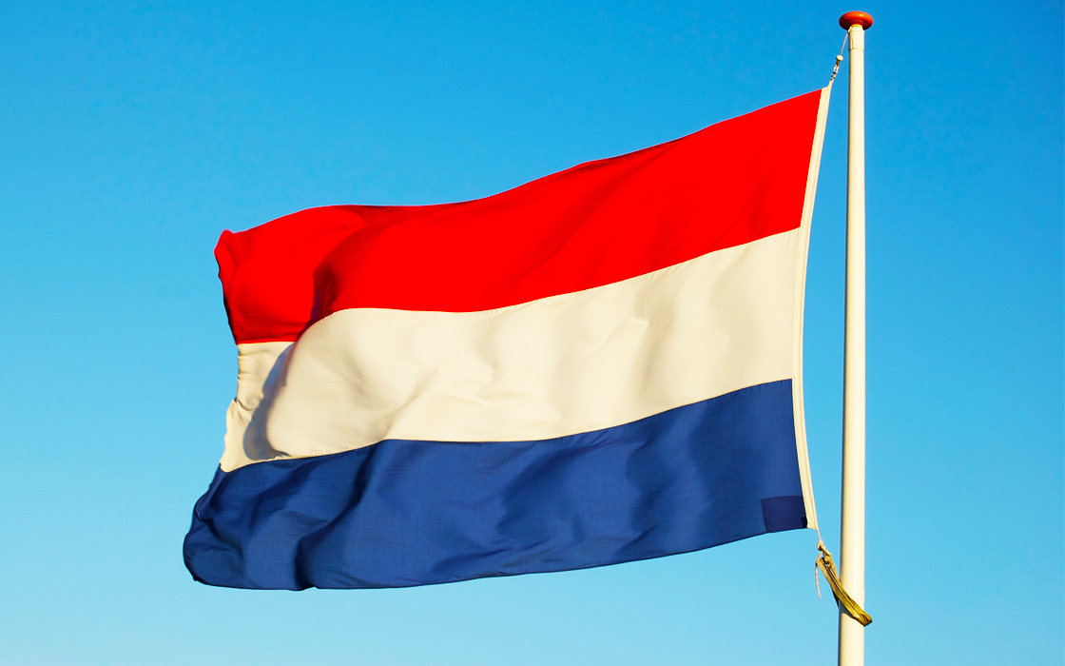
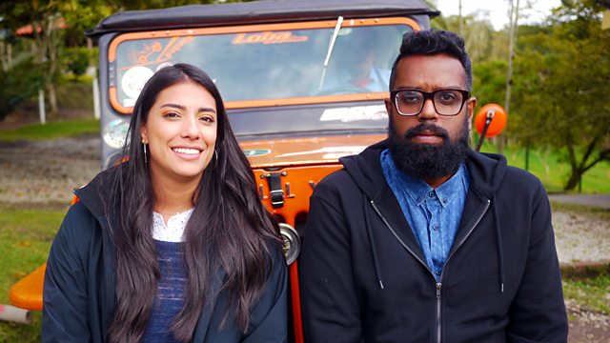
CHOSEN TOPIC PLAN
Question: Are the public acting on climate change coverage in the media?
Dissertation: I will talk about how personally, I feel that even though the media is filled with the climate change crisis and how we need to do something about it, the normal everyday people aren't doing what they need to do to save the planet.
Documentary: For my video I will show my personal trip to The Netherlands and include my experiences, sightseeing and feelings. Just like ‘The Misadventures of Romesh’ I will have an educational side to it where I will talk about the history of cycling in Holland. I will also take a look at any trends I find and ask the public about their opinions on them, for example they don’t wear helmets. This will help me to get a real life Dutch view and give my documentary more depth. I will have cinematic establishing shots to fill in the gaps and make some parts where there is just a voiceover more intriguing and interesting.

Slide 5
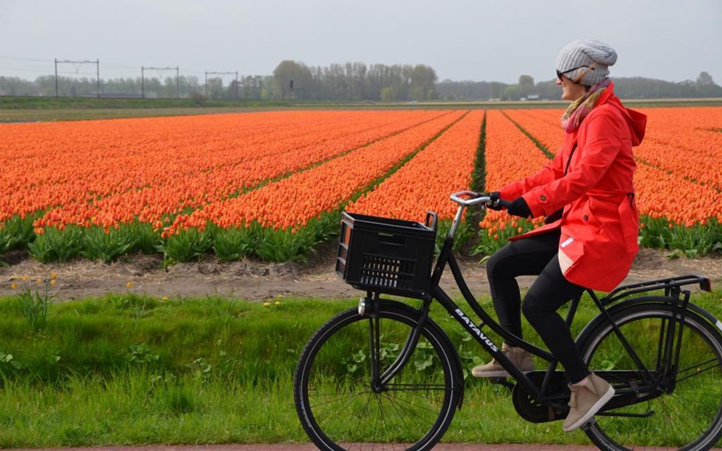
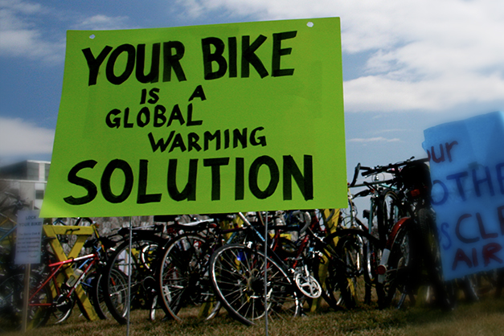
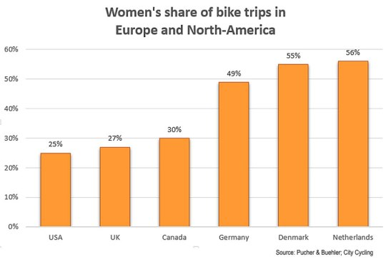
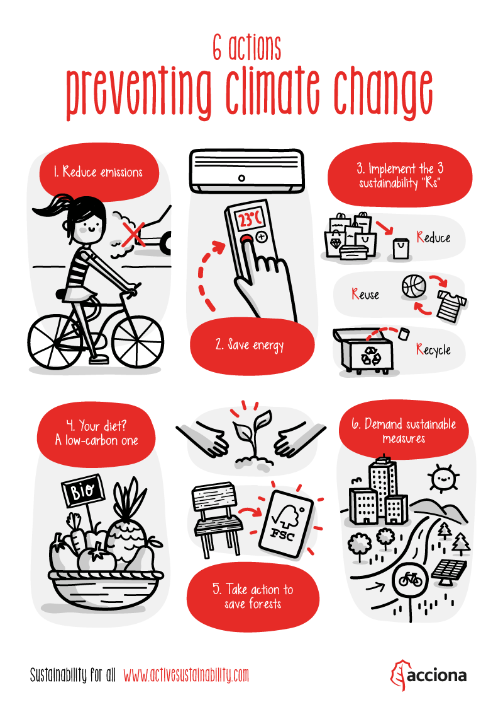
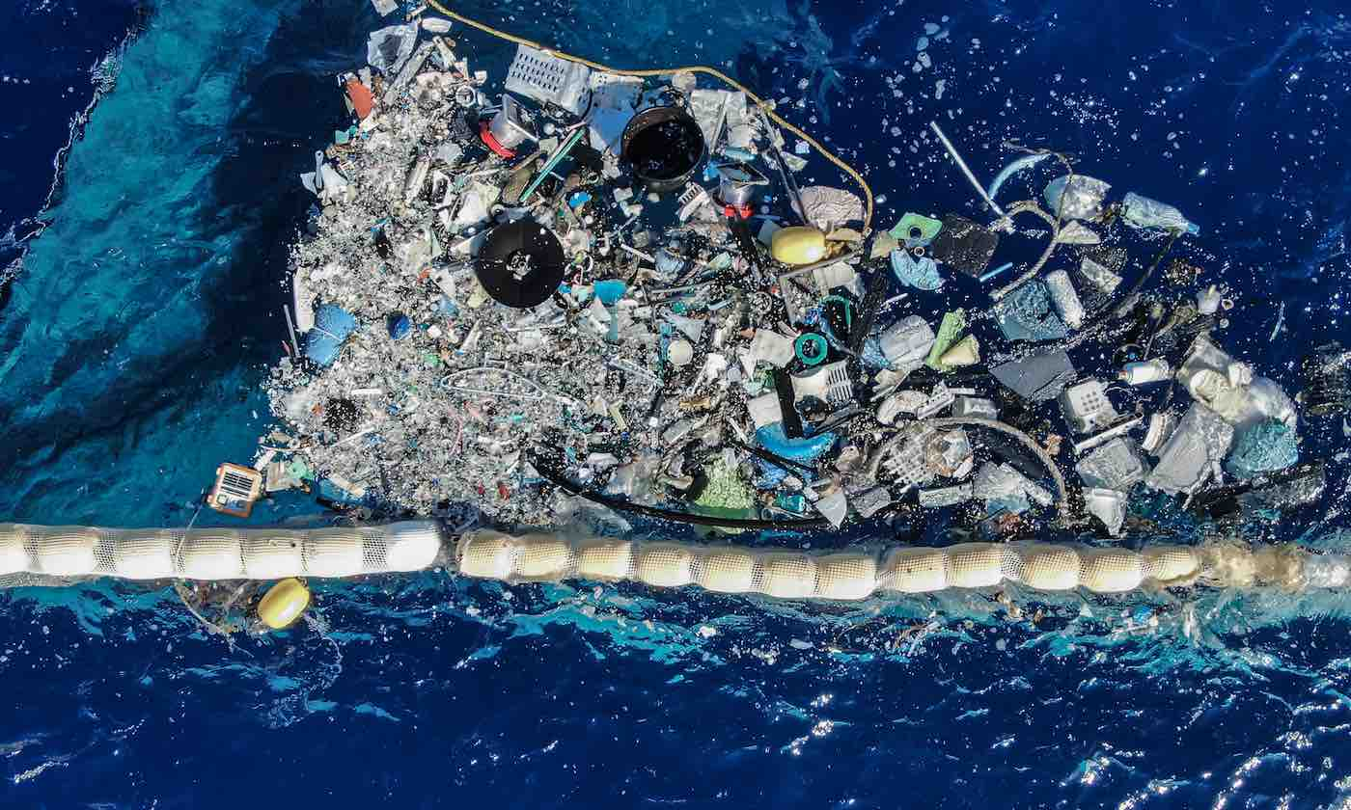
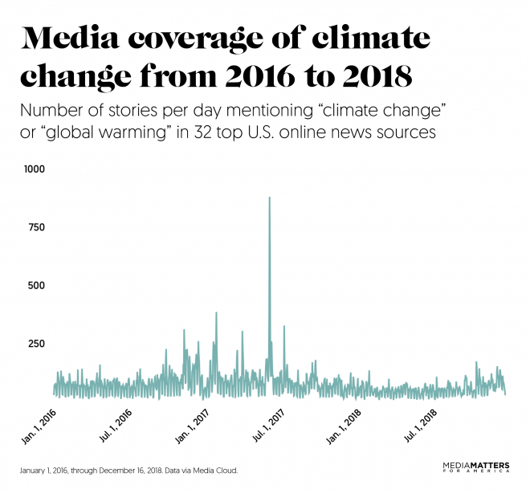
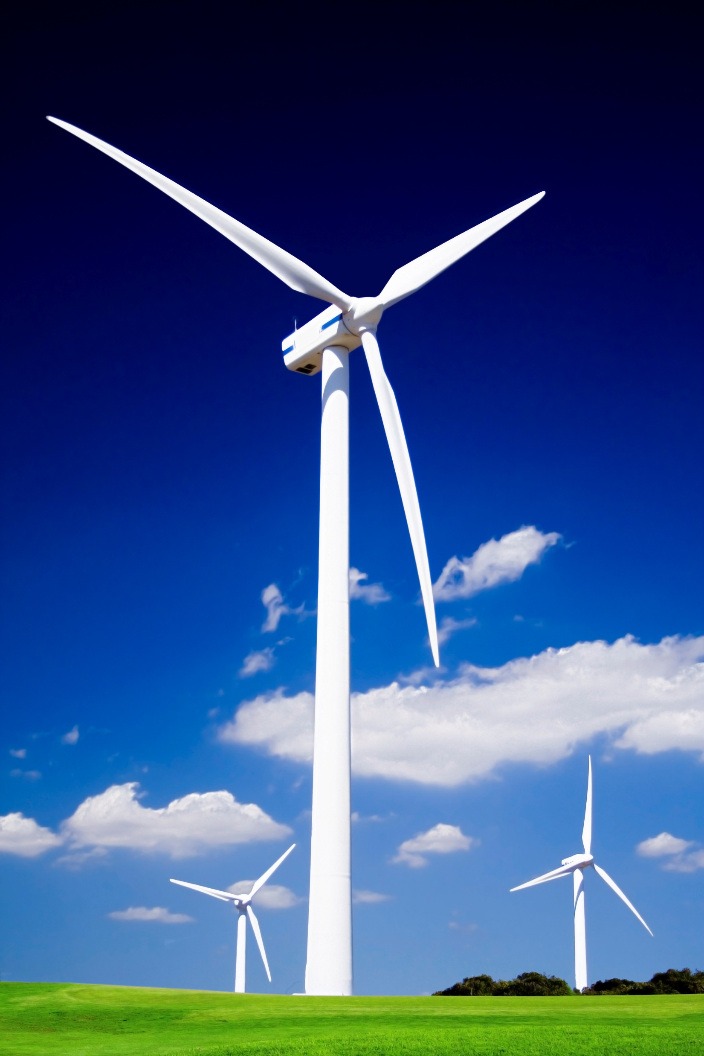
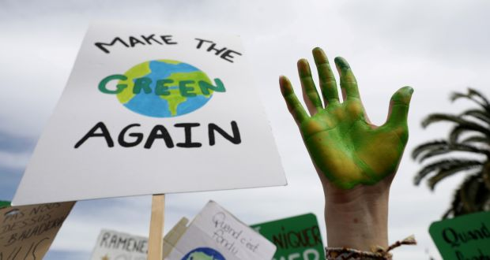
DISSERTATION TOPIC RESEARCH
https://www.bbc.co.uk/news/magazine-23587916
https://www.youtube.com/watch?v=gUe_e6gmkeI
https://www.activesustainability.com/climate-change/6-actions-to-fight-climate-change/
https://www.theguardian.com/environment/2017/
jan/19/how-to-reduce-carbon-footprint

Slide 6
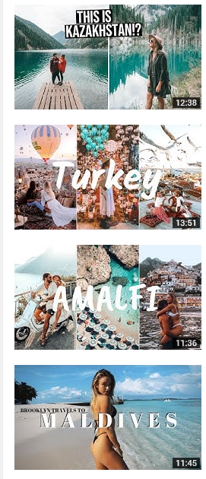
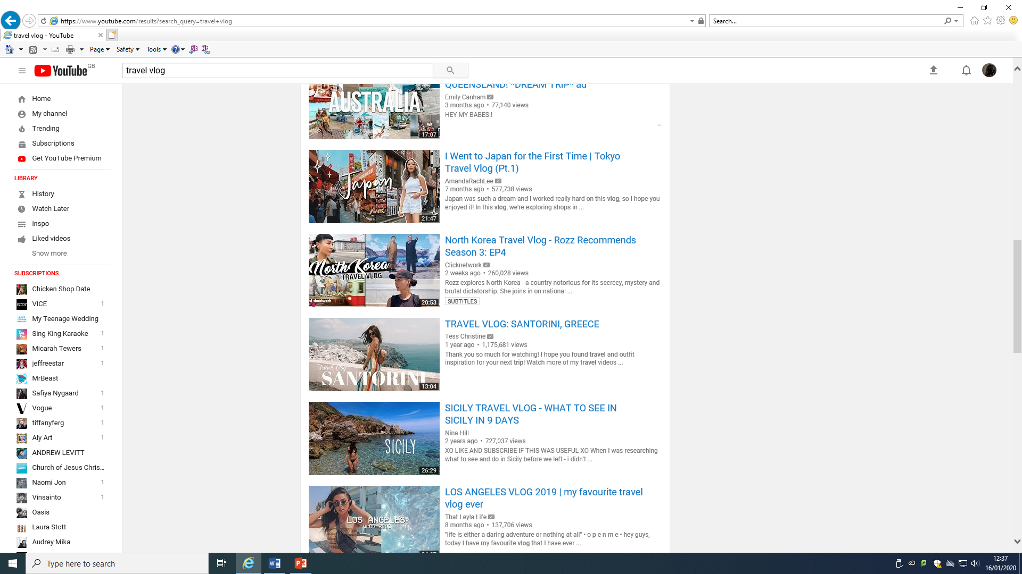
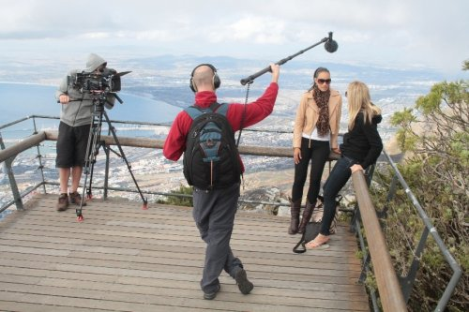
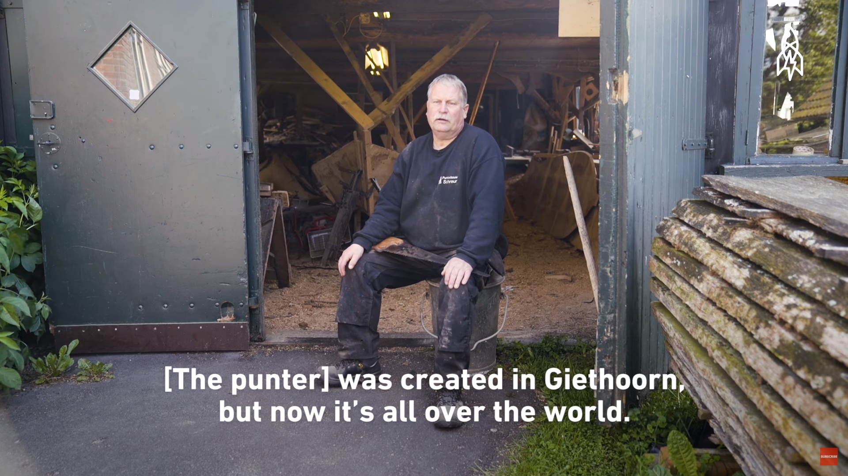
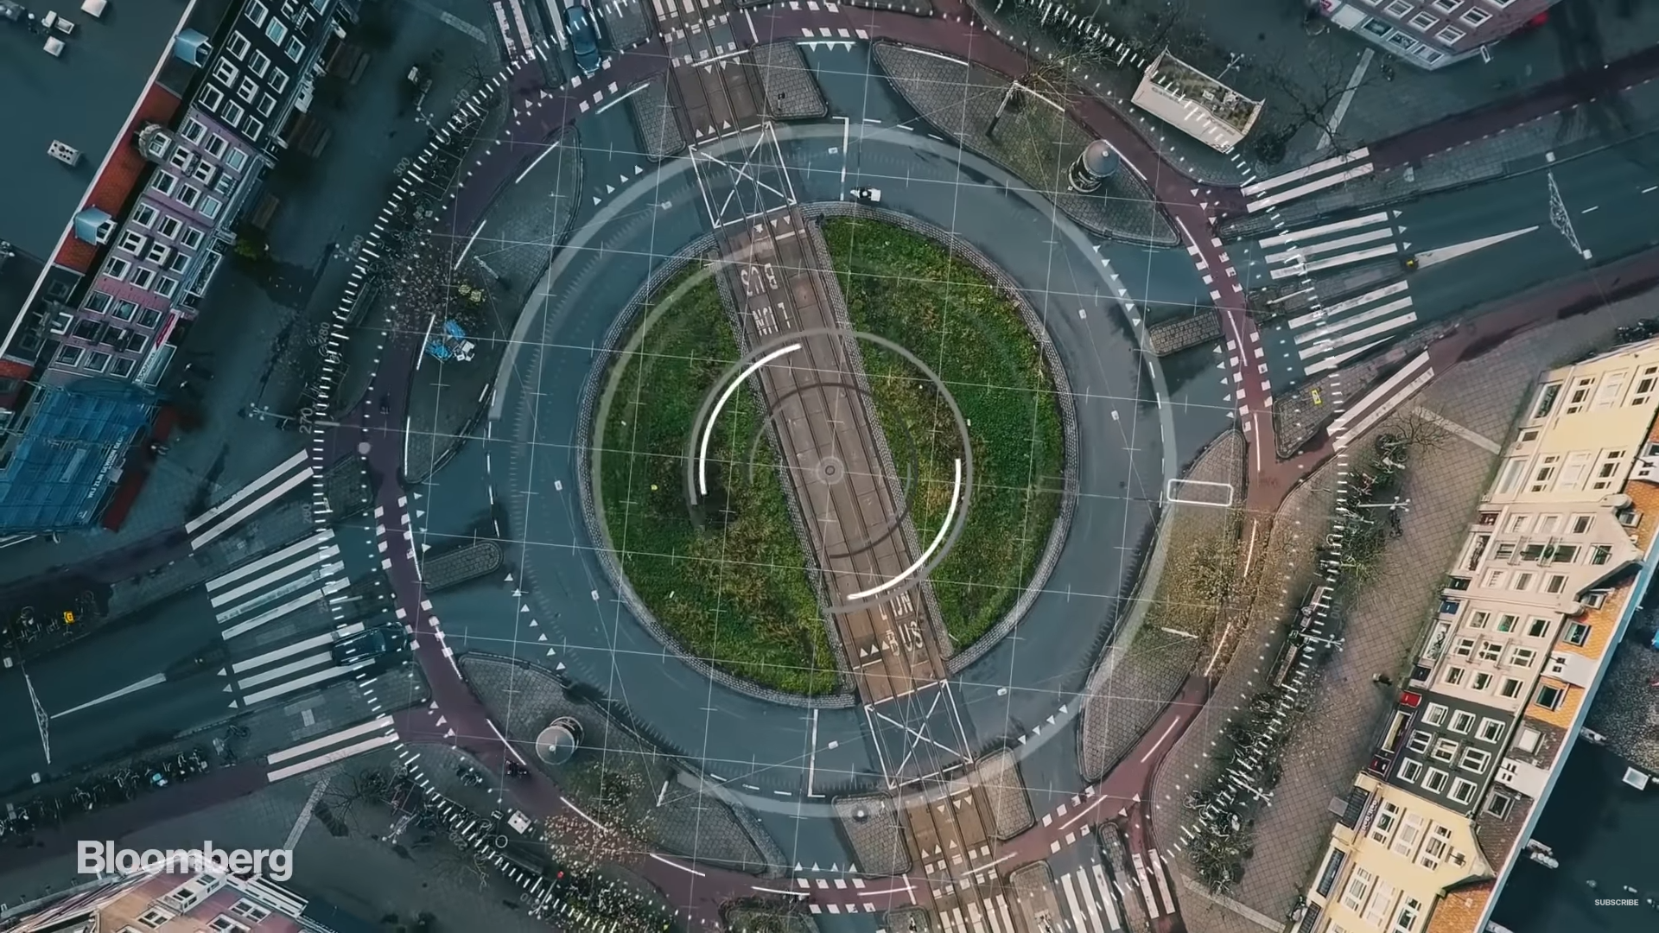
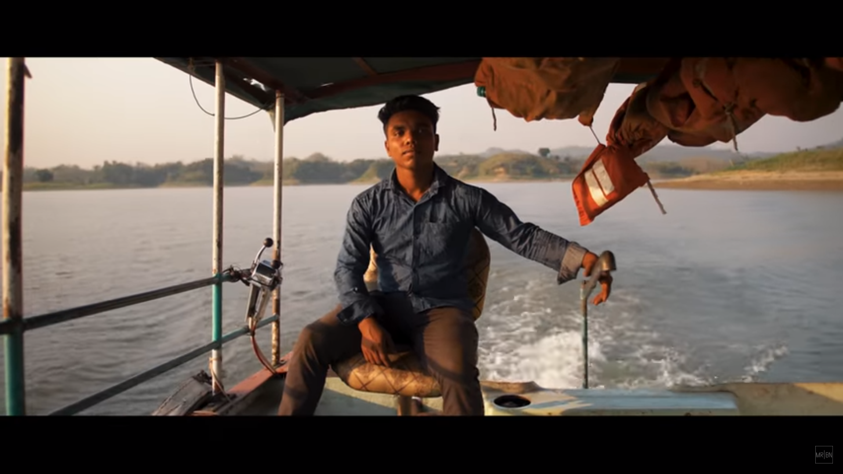
VIDEO INSPIRATION
When you type in ‘Travel Vlog’ into YouTube these are the videos that come up, they have a very similar look to their thumbnails. They use bright colours; mostly turquoise with bold white text of the countries name. These videos however, are fairly informal and have a lot of shaky front facing video, so I think I will make mine more formal and professional than this.
https://youtu.be/R3t1cg2ZOxc - No Roads, No Cars, Just Boats
This documentary is very light hearted and uses an upbeat background music. They have also interviewed Dutch villagers and added captions in English.
https://youtu.be/DKbRL6Opifg - How Amsterdam Became a Bicycle Paradise
This video is much more informative than others, it uses after effects animations to make stats more interesting. The whole video is narrated and this allows the shots to have explanation.
https://youtu.be/rDYdeq3JW_E - BANGLADESH | Raw Beauty
This travel documentary is different to others, as it uses music for the basis of it. All the shots transition in time with the music and he has also added sound effects to merge the video to the music.

Slide 7
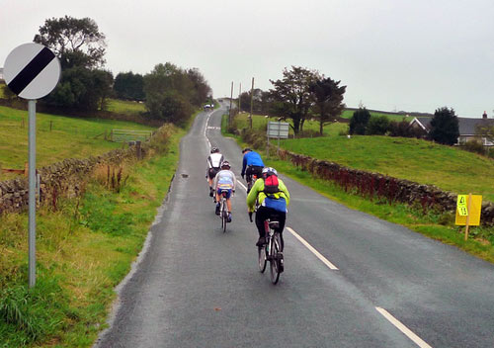
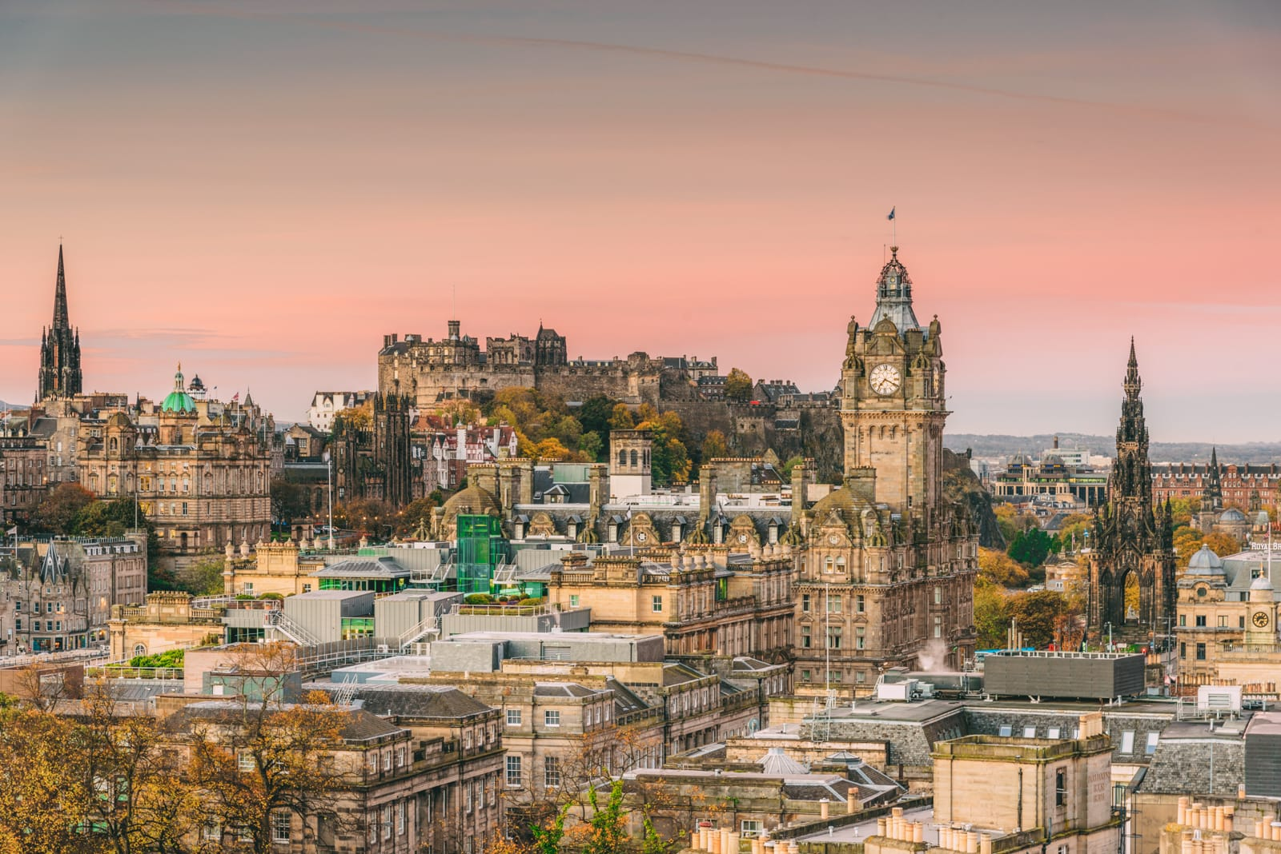
LOCATION RESEARCH - ENGLAND
Hill ranges in England
Salisbury Plain – Walbury Hill at 297 metres
Greensand Ridge – Leith Hill at 294 metres
South Downs – Butser Hill at 270 metres
North Downs – Botley Hill at 268 metres
Chilterns – Haddington Hill at 267 metres
Yorkshire Wolds – Bishop Wilton Wold at 246 metres
8 Best Places to Visit in the UK
London: The UK's All-in-One Destination
Edinburgh: Scotland's Capital
Roman-Era Bath
Ancient Stonehenge and Medieval Salisbury
Wonderful Windsor
Idyllic England: The Cotswolds and Lake District
Medieval York and its Minster
The University Towns of Cambridge & Oxford

Slide 8
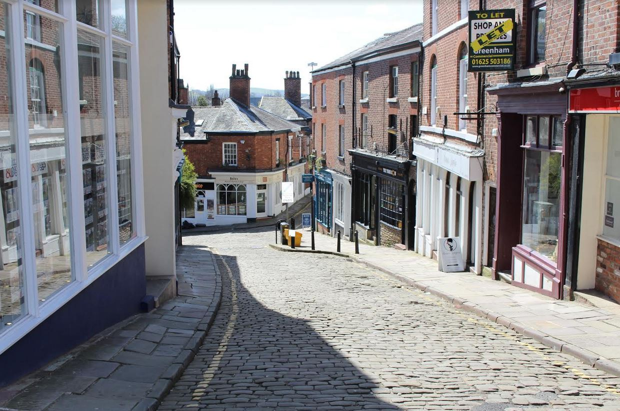
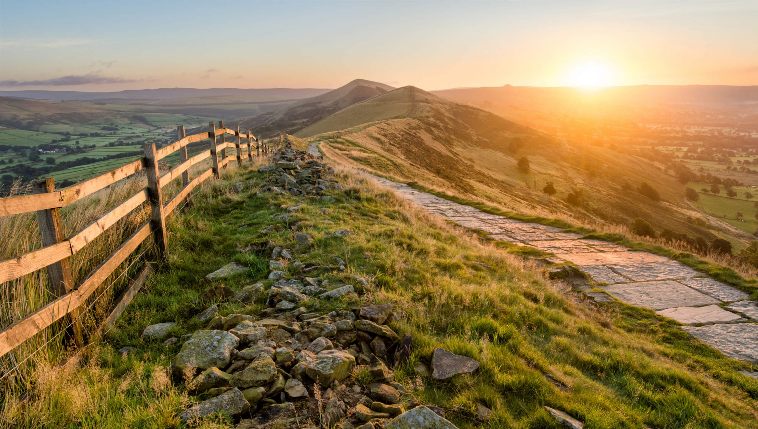
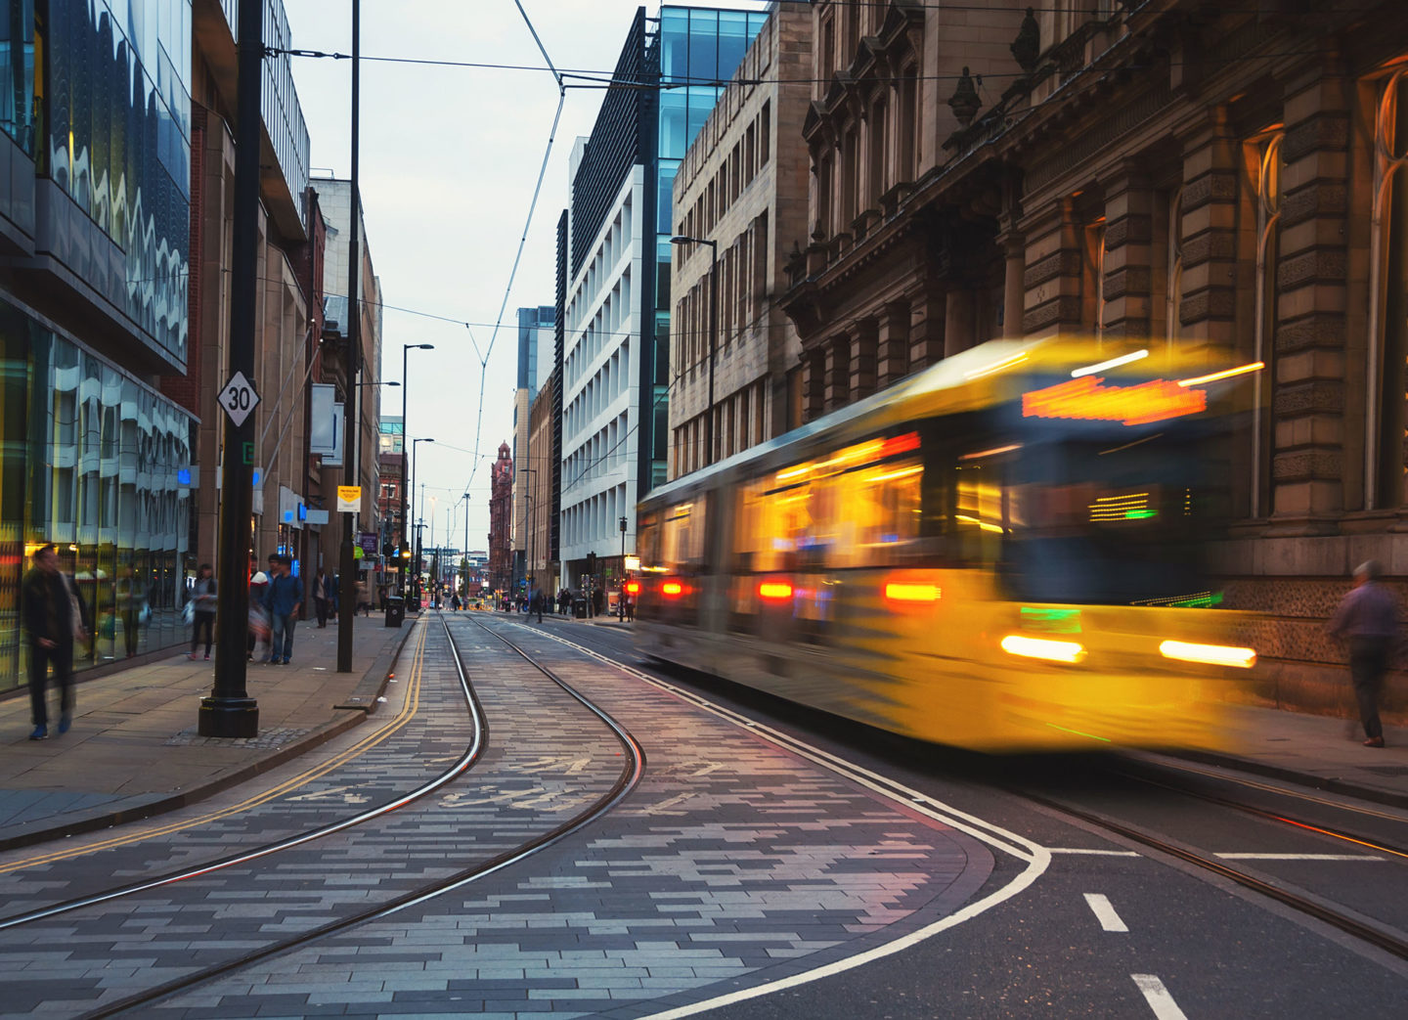
CHOSEN LOCATIONS - ENGLAND
Macclesfield – The town where I live now, for the backstory part of my documentary. I will film re-enactments of my past experiences of riding to high school and other places. [no location release needed]
The Peak District – This location is to show that there are big hills in England, making it hard to ride my bike without getting to my destination tired and sweaty. [no location release needed]
Manchester – This location will be very short just to show that it can be quite dangerous to ride your bike on the roads. I will show the buses and the amount of people to show how busy it is. Also, this location will be for showing how much I have to lock my bike up for it to be safe. [no location release needed]
Manchester Airport – This location is for the transition shot from England to The Netherlands, I will be filming mostly o the actual plane. I will film myself walking on the moving walkway.

Slide 9
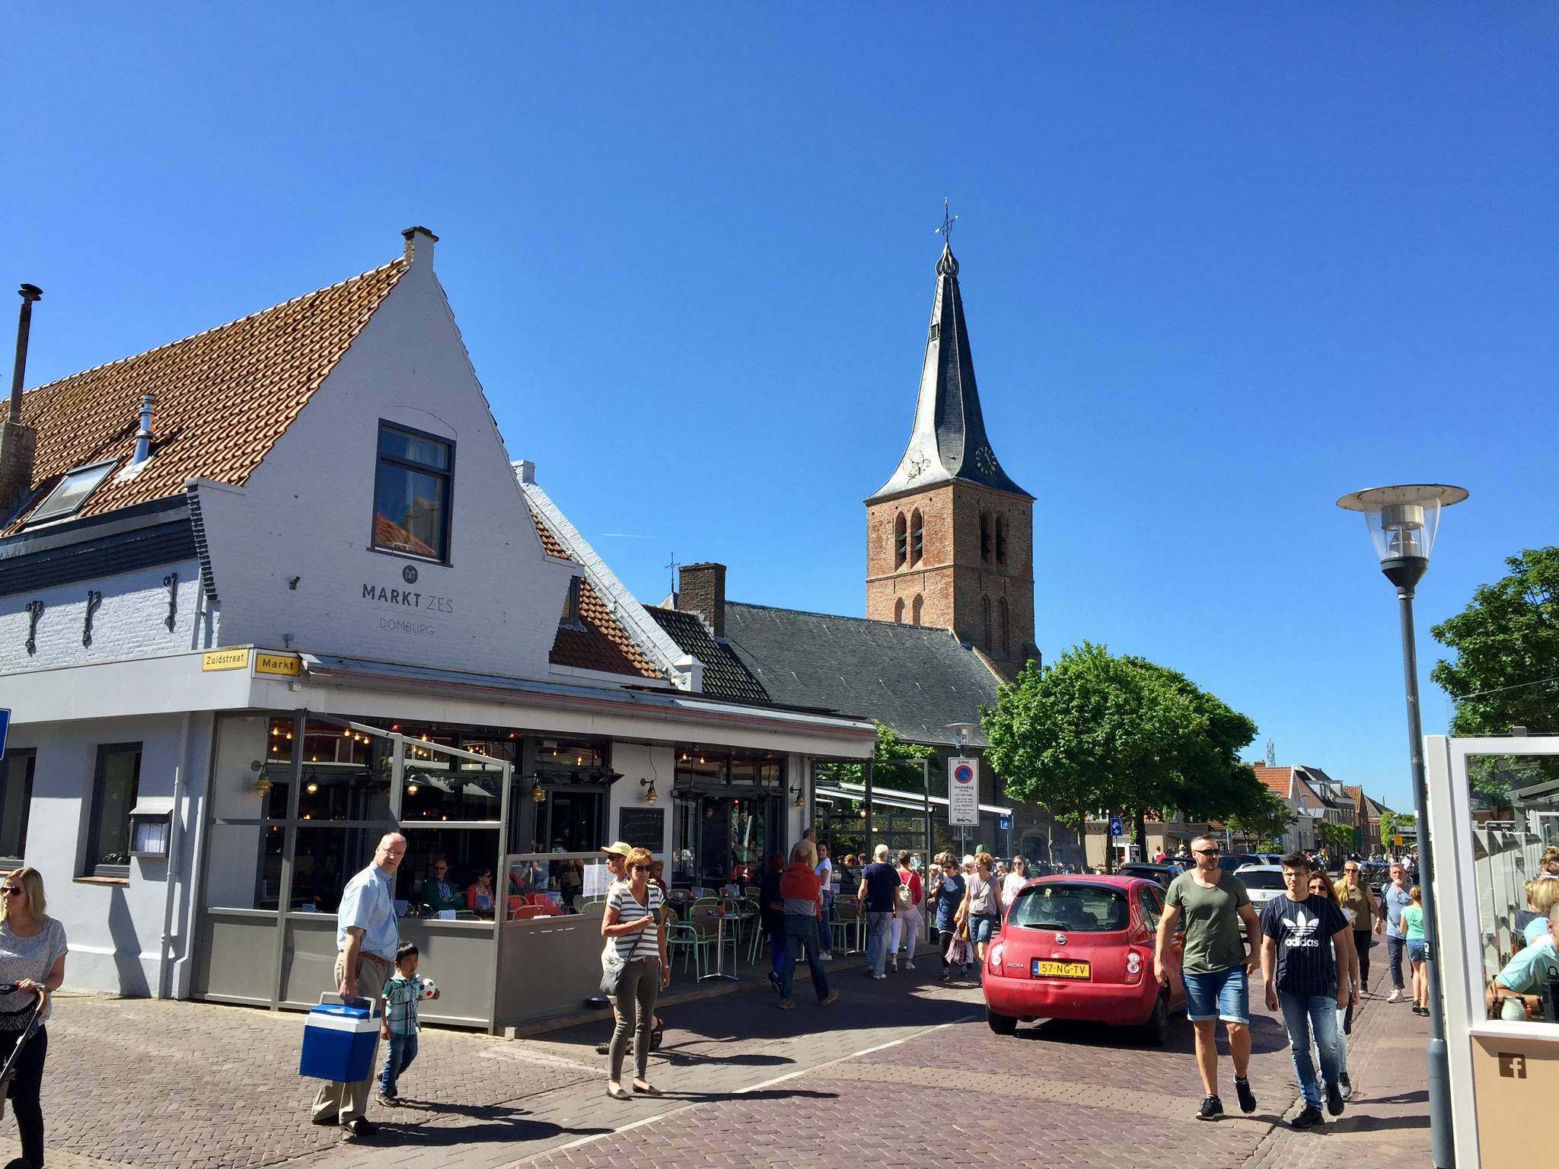
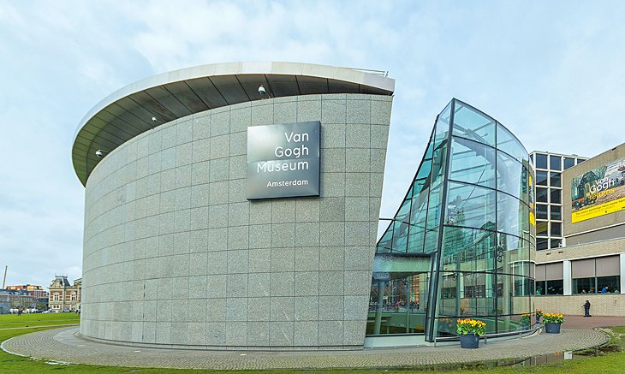
LOCATION RESEARCH - HOLLAND
Top 10 places to cycle in The Netherlands
Brutgebiet – Oudeschild - Haven Loop from Den Hoorn
Promenade – Vorbei am Oolderplas Loop from Roermond
Oosterschelde Nationalpark – Entlang der Oosterschelde Loop from Burgh-Haamstede
Domburg – Ijzeren Torentje Loop from Zoutelande
Ijzeren Torentje – Westkapelle Loop from Domburg
Oosterschelde Nationalpark – Entlang der Oosterschelde Loop from Noord-Beveland
Wasserkraftwerk Linne – Schleuse und Wehr Linne Loop from Roermond
Aussicht auf Sandstrand – Pferde in freier Wildbahn Loop from West Repart/Dolfijn (RTM)
Heidelandschaft – Weiße Dünen Loop from Groet
Radschnellweg – Herrlicher Dünen-Fahrradweg Loop from Noordwijk
Top 10 tourist locations in The Netherlands
Jordaan and Amsterdam's Canals
Keukenhof
The Rijksmuseum, Amsterdam
Anne Frank Museum, Amsterdam
Van Gogh Museum, Amsterdam
The Windmills of Kinderdijk
Hoge Veluwe National Park
Towns of the Ijsselmeer
Zeeland's Spectacular Dikes
Historic Valkenburg

Slide 10
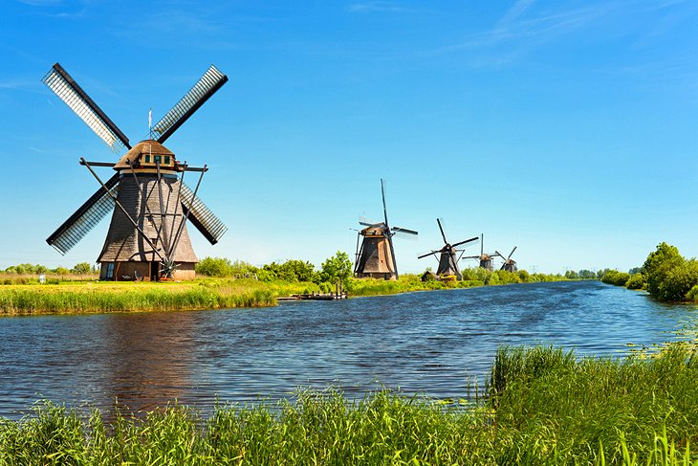
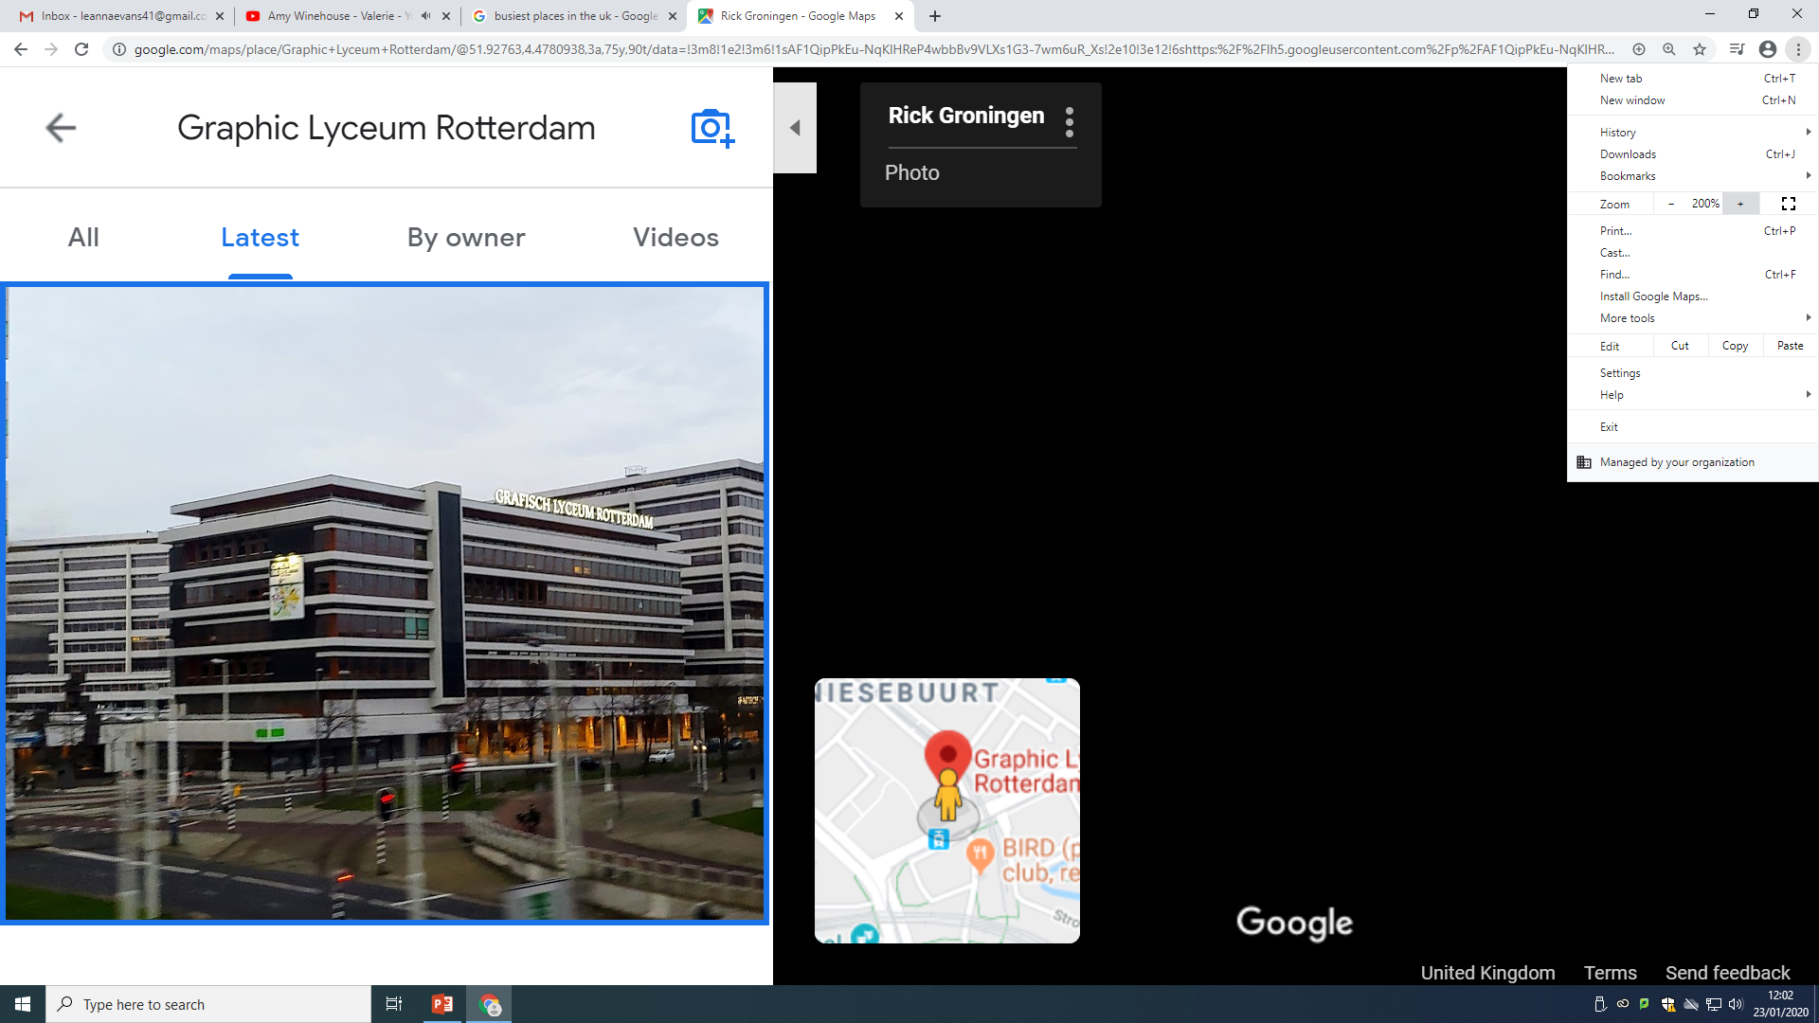
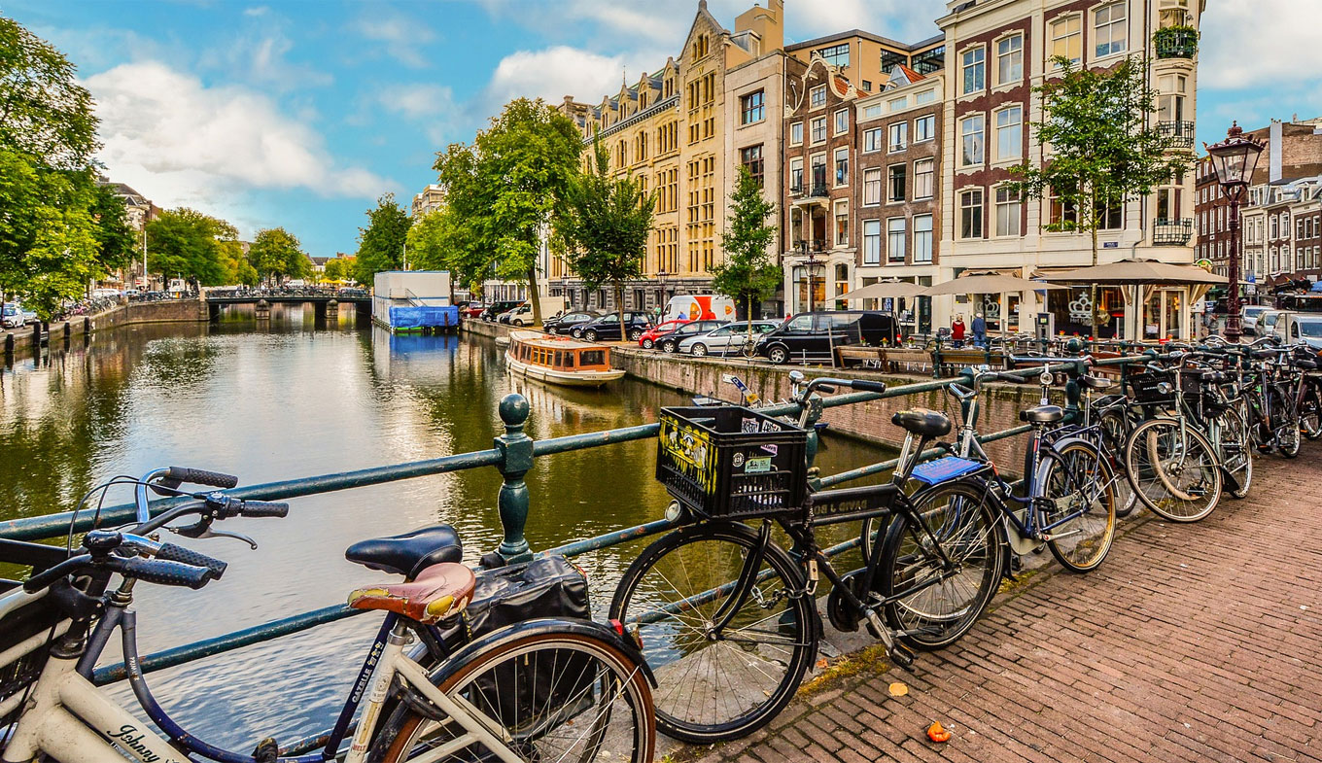
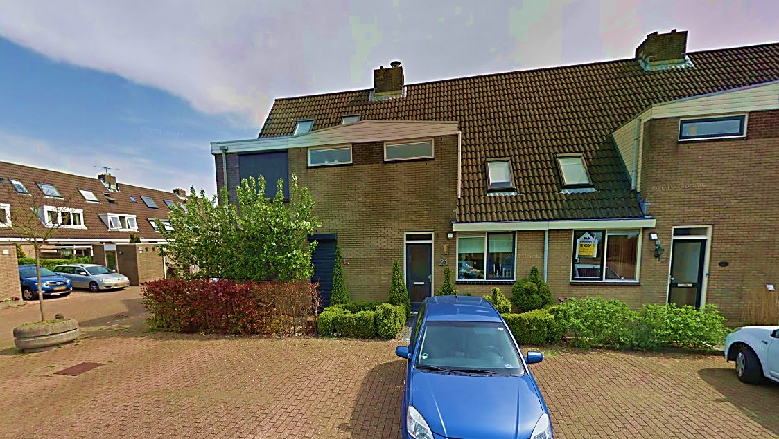
CHOSEN LOCATIONS - HOLLAND
The Windmills of Kinderdijk – I chose this location, as it is very iconic to The Netherlands and will help me to get a lot of cinematic shots. There are also a lot of cute paths that I can get some good bike shots in. [location release needed]
Graphic Lyceum Rotterdam – This location is for doing my interview about the youth and cycling to school. I will also do interview of people on the street asking about their opinions on cycling in The Netherlands. [location release needed]
Amsterdam – This is the capital and so will have lots of sights I can film. I will also be able to get shots of lots of people cycling through the city and parked bikes too. [no location release needed]
Boskoop – This is where I will be staying and so, will film the local neighbourhood and use it for simple cycling shots. This is where I will do sitting down talking just of me.

Slide 11

DOCUMENTARY STRUCTURE RESEARCH
Start with an introduction with a voiceover to introduce the audience to the making of the film. The introduction will also include clips from interviews from the main section to introduce the cast and crew from the film. This gives the audience a little taste of what is to come and what to expect.
The main section will include interviews from the cast and crew of the film, video clips to go with the interviews, and facts and information about how the film was made and what inspired the story.
Your conclusion may include the answer to a question asked in the introduction, or the end of a journey started in the introduction. You may wish to include information about the subject at the end of your info film with a call to action, which is a way the audience can respond to what they have just watched.
1) Interviews
2) B-roll
3) Real Life Footage (Cinéma Vérité)
4) Process Footage
5) Archive

Slide 12
MAIN SCENES IN ORDER
KEY:
Scene - Location / Actors
Introduction to me - Macclesfield / Me
My experience with cycling in the UK - Macclesfield, Manchester, Peak District / Me, Dad, Mum, Millie
Quick short shots of me packing up and getting on the plane - Airport, Macclesfield / Me
Introduction to The Netherlands with cinematic shots - Various places in Holland / Me, Public
The history of cycling - Not Applicable
Interviews with the public - Amsterdam / Public
More cycling shots and my experiences - Various places in Holland / Me
Interviews with the youth of The Netherlands - Art School, Rotterdam / Hannah, Me, Hannah’s Friends
Overall experience and montage - Various places in Holland / Me
Back in England and ending - Airport, Peak District, Macclesfield/ Me

Slide 13
BIBLIOGRAPHY
www.bbc.co.uk/news/av/magazine-23624886/cycling-from-the-hague-to-westminster
www.youtube.com/watch?v=gUe_e6gmkeI
bicycledutch.wordpress.com/2015/03/08/women-cycling-make-it-happen/
www.theguardian.com/commentisfree/2018/jun/13/safety-women-cycling-roads
www.cyclist.co.uk/in-depth/1265/are-you-breaking-the-law-when-you-ride-your-bike
www.youtube.com/watch?v=Q5550yRjQZE
www.austinadventures.com/travel-resources/9-fun-facts-about-holland/
www.holland.com/global/tourism.htm
www.thesun.co.uk/travel/10640024/holland-wont-exist-anymore-the-netherlands/
www.holland.com/global/tourism.htm
www.bbc.co.uk/news/magazine-23587916
www.komoot.com/guide/532/cycling-in-the-netherlands
www.planetware.com/tourist-attractions/netherlands-nl.htm
www.planetware.com › england › best-places-to-visit-in-the-uk-eng-1-2

