Slide 1
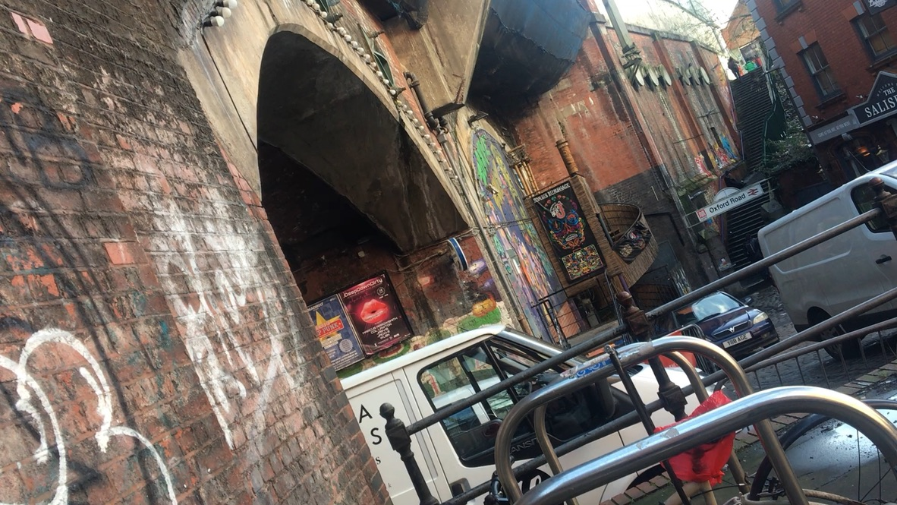
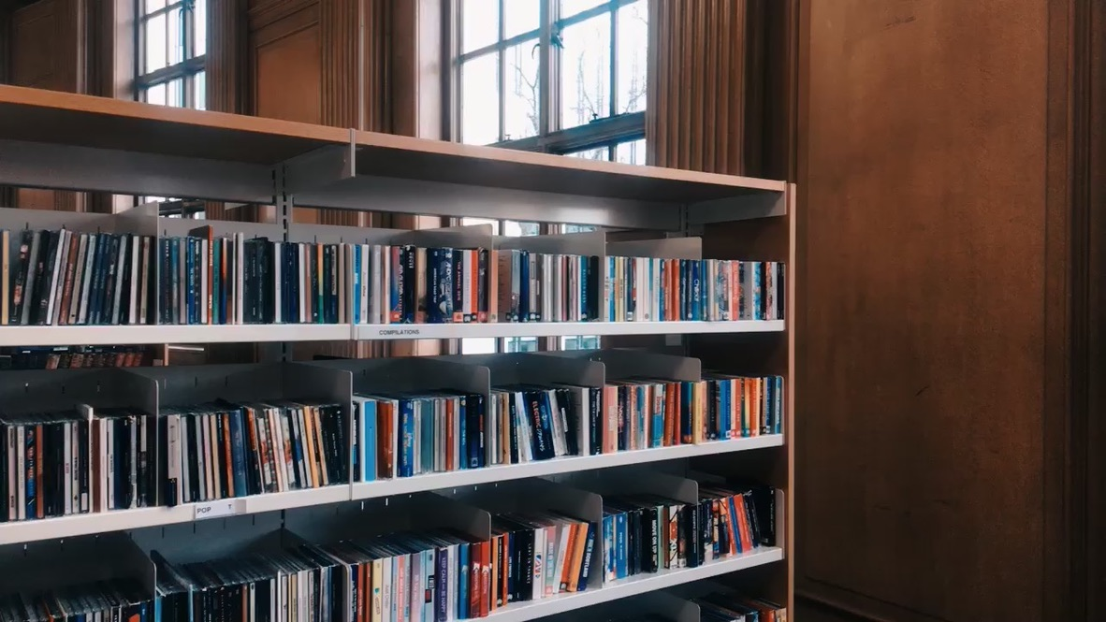
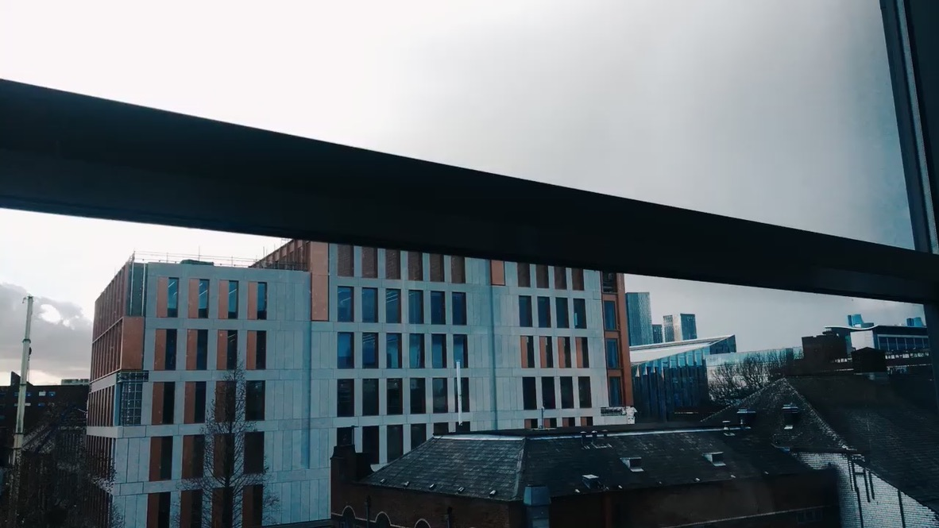
EXPERIMENTATION - CITY
For my first experimentation I went into central Manchester, in order to practice and experiment with a city location. This will help for when I go to Amsterdam and I need to make sure I know how to frame tall buildings, bikes locked up and a library. I research different places in Manchester that will ensure I have a varied amount of location types that you would find in a city. I will be using the framing for the bike locks and I also did a panning movement, which turned out very effective. However I will probably have to use a gimble when I film it again so that is isn’t so shaky.
Bike Locks MS - Manchester
Skyscrapers ES - Manchester
Library LS - Manchester

Slide 2
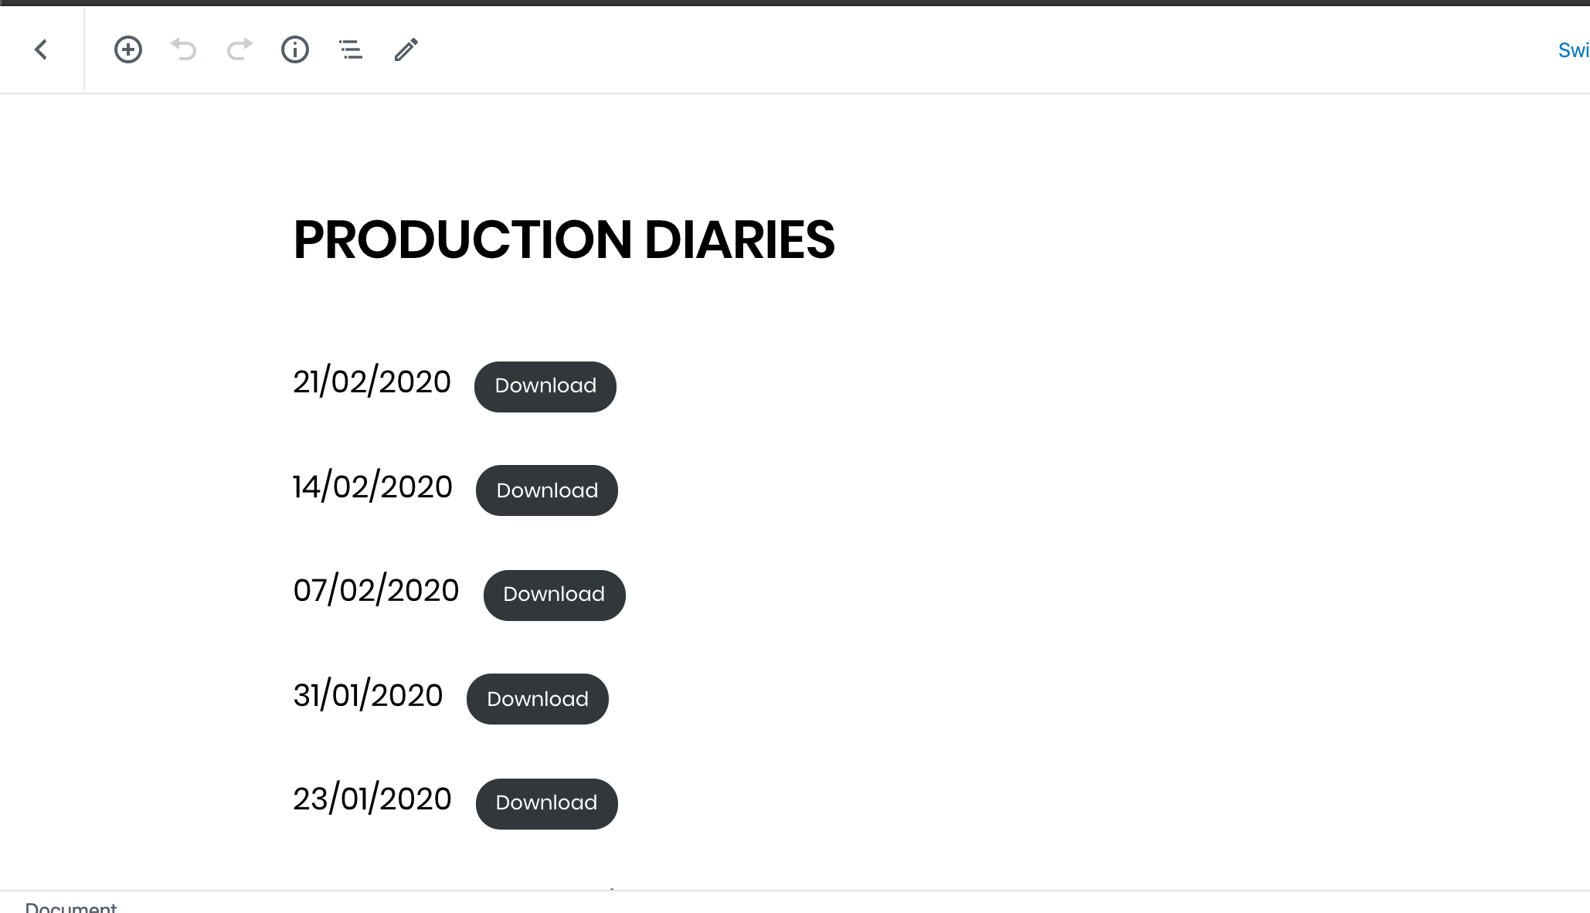
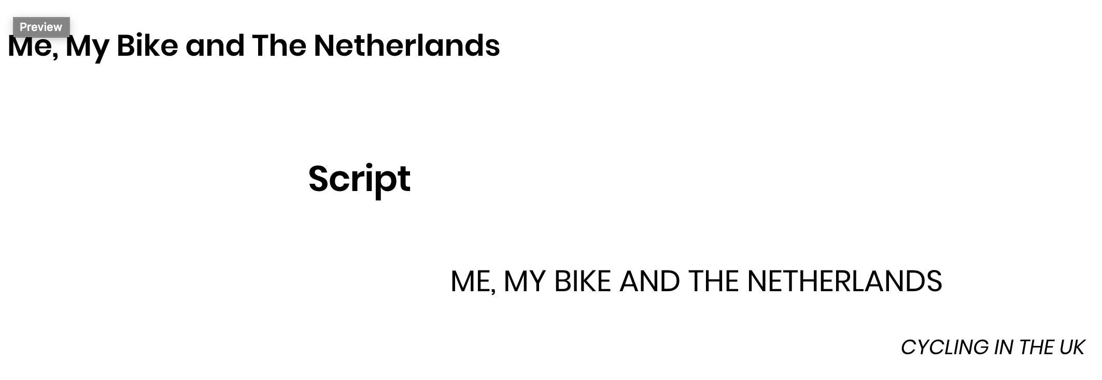
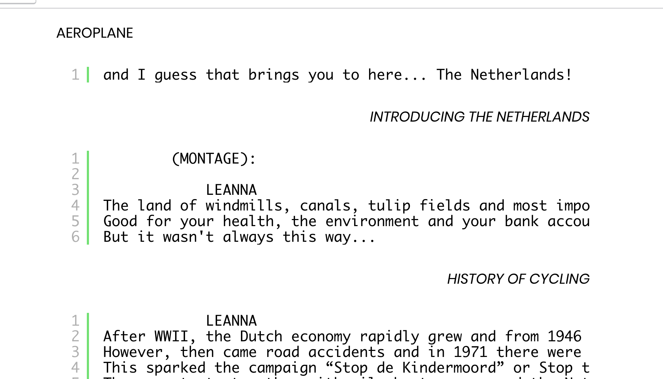
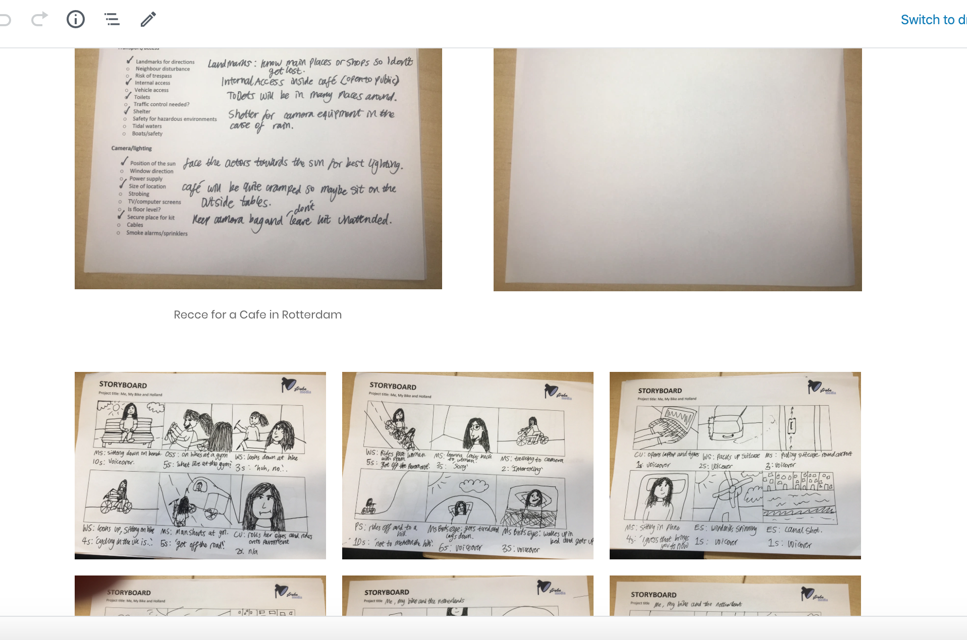
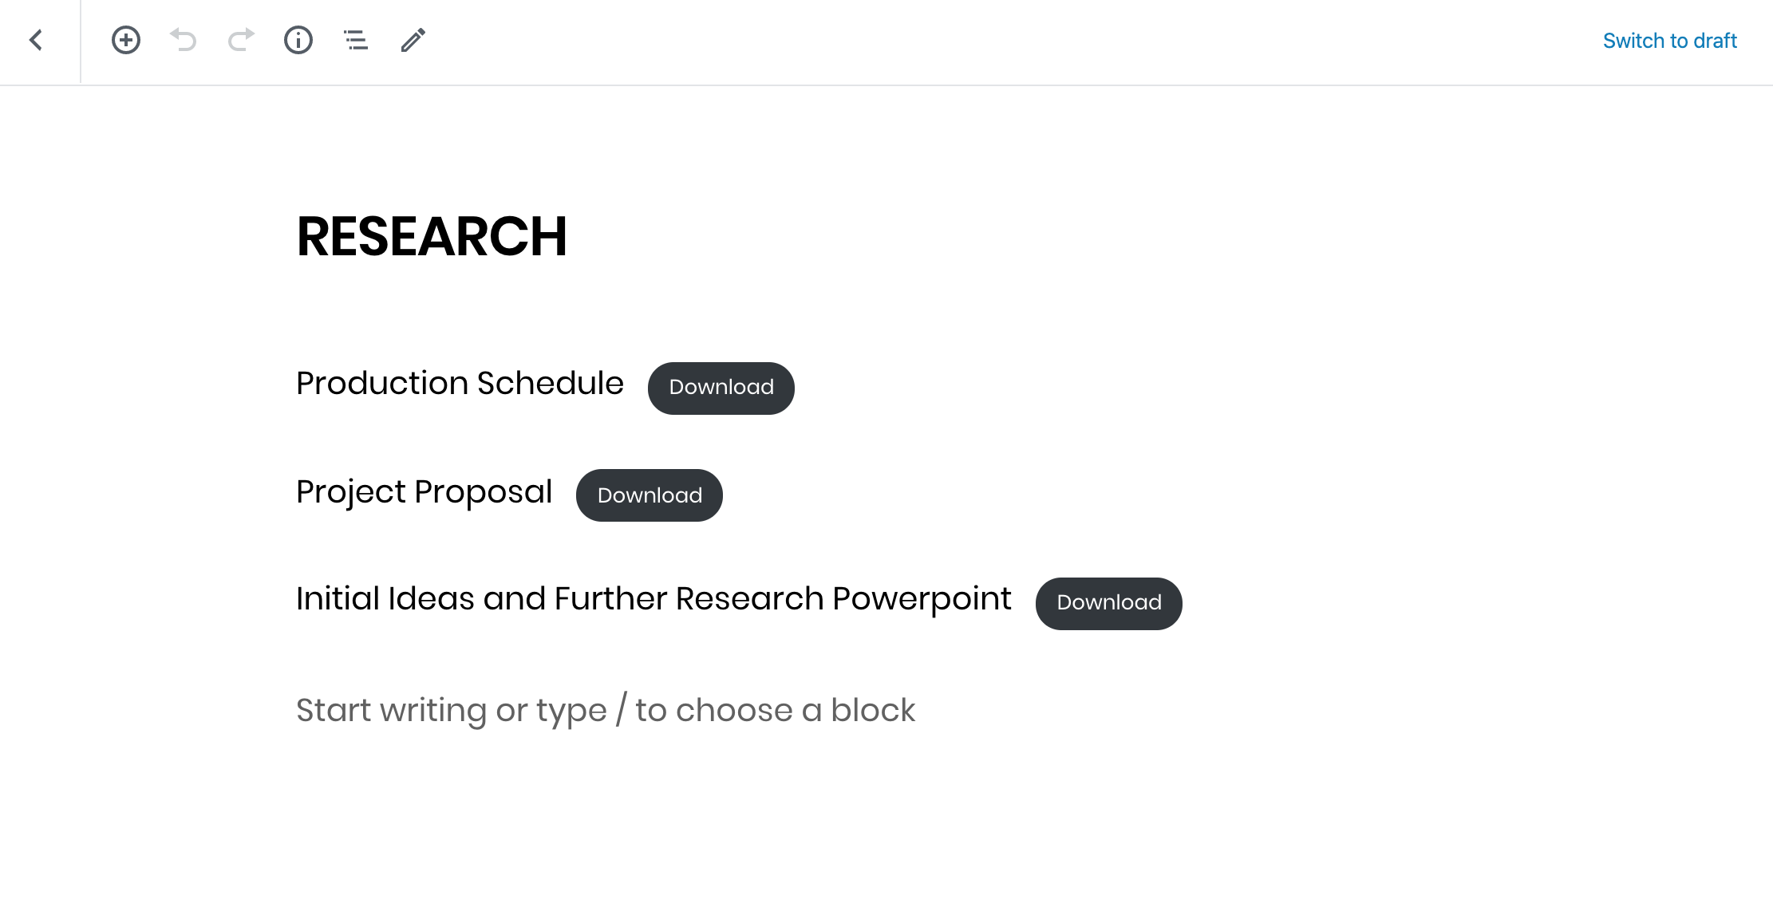
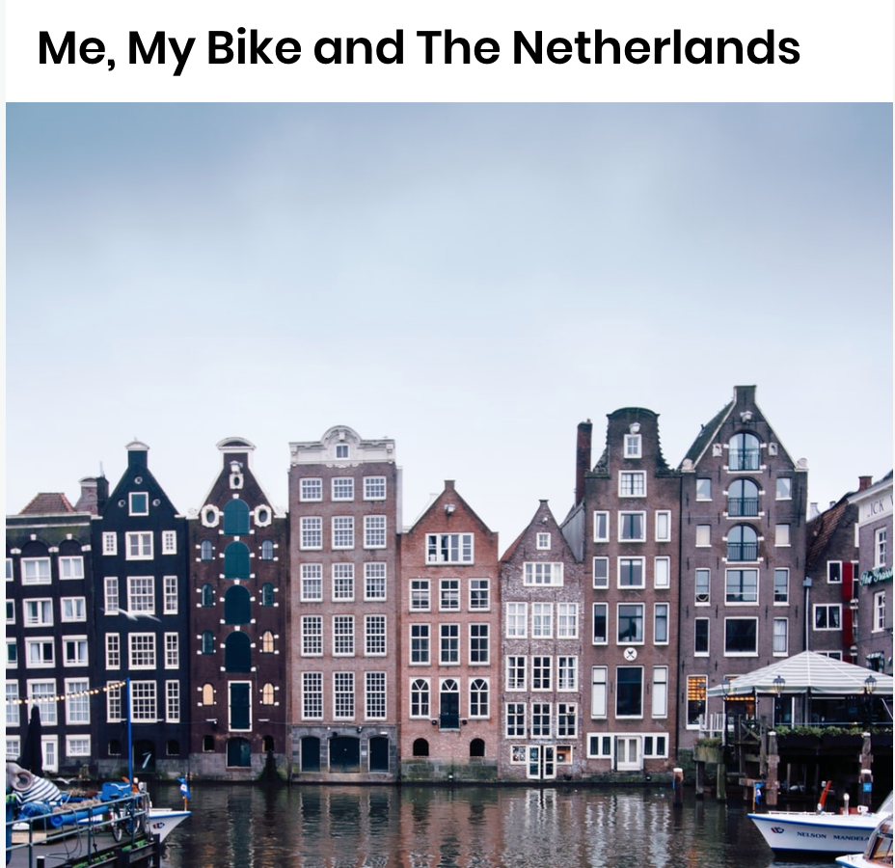
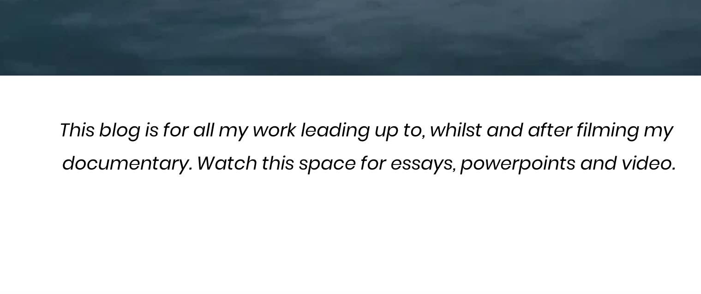
EXPERIMENTATION - WEBSITE
For physical documents like my storyboards, I just took a picture of it and uploaded it as an image file onto my website. This means that they are easy and quick to read.
I was able to copy my script from celtx into my website, I had to keep the typewriter font and paragraphing.
For my production diaries I used the file insert tool and just have them as a download link. This is because the file wouldn’t be the same if I converted it to a website. I then did this for my research files too.
For my homepage I started off with a blank canvas of just the title and the navigator. Then I added a picture and put the title over it, but I didn’t like the colours and so changed the picture and also added a short description of what my website includes.

Slide 3
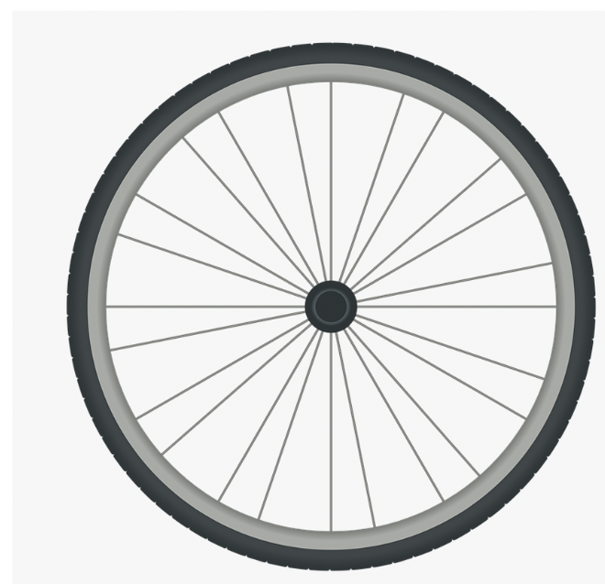
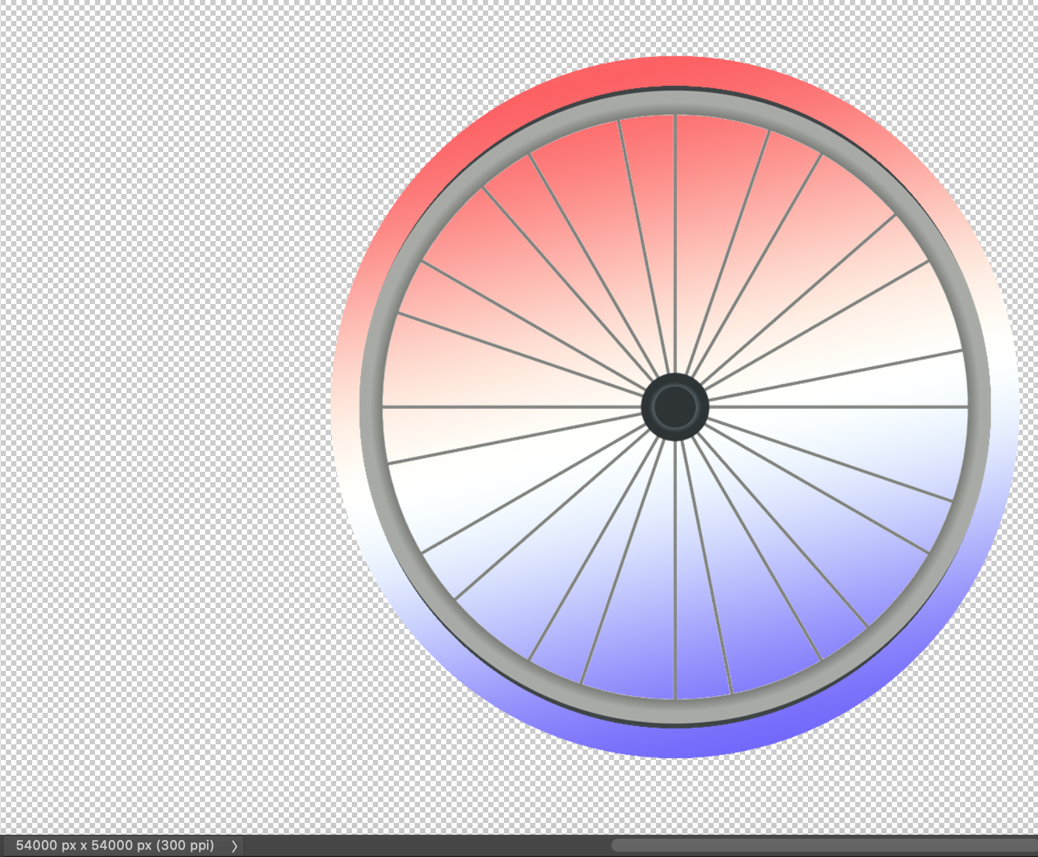
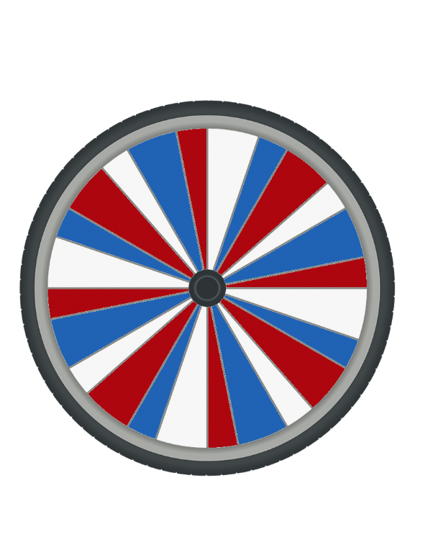
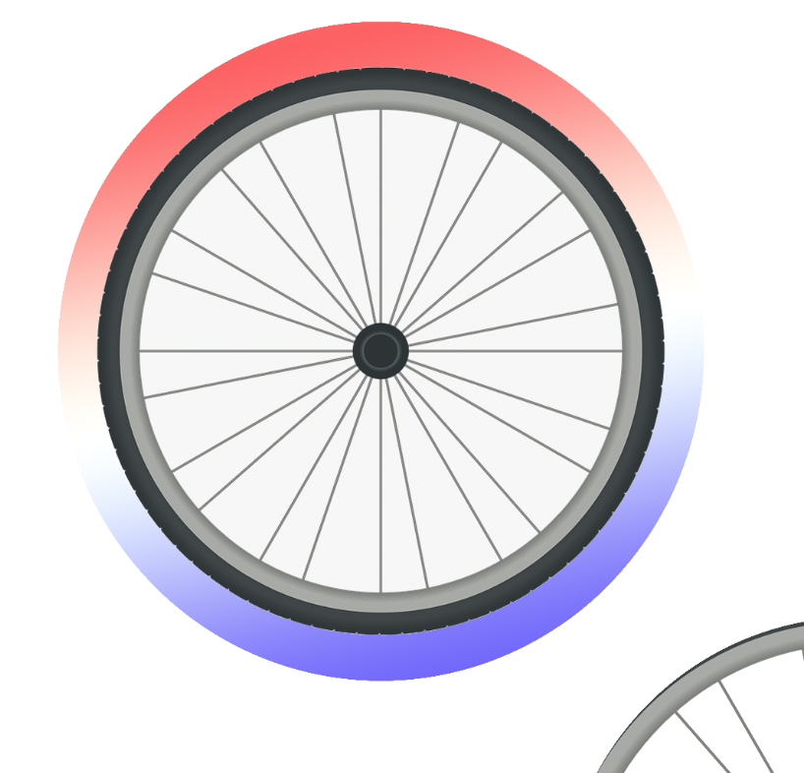
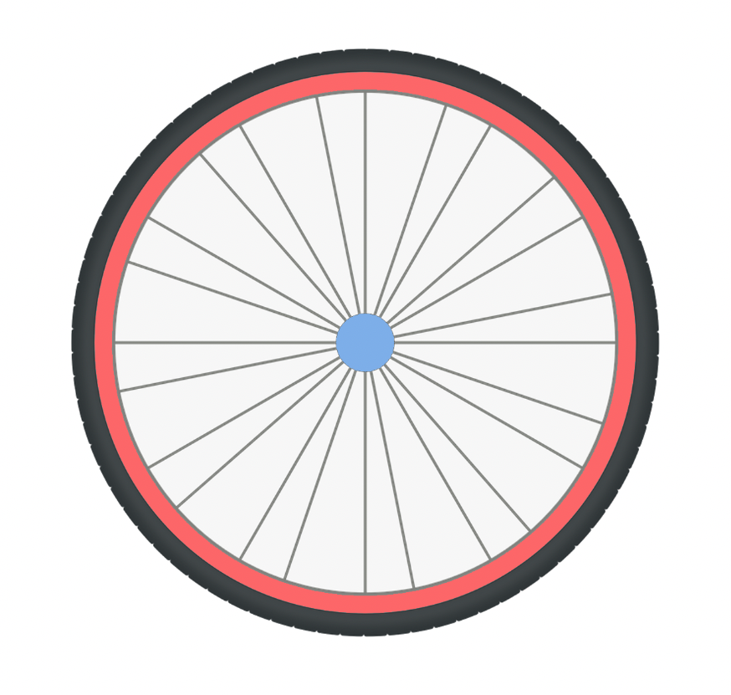
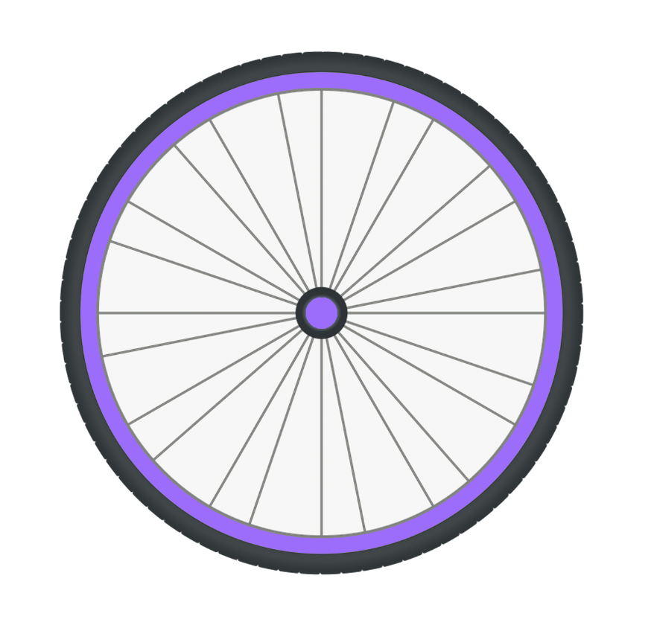
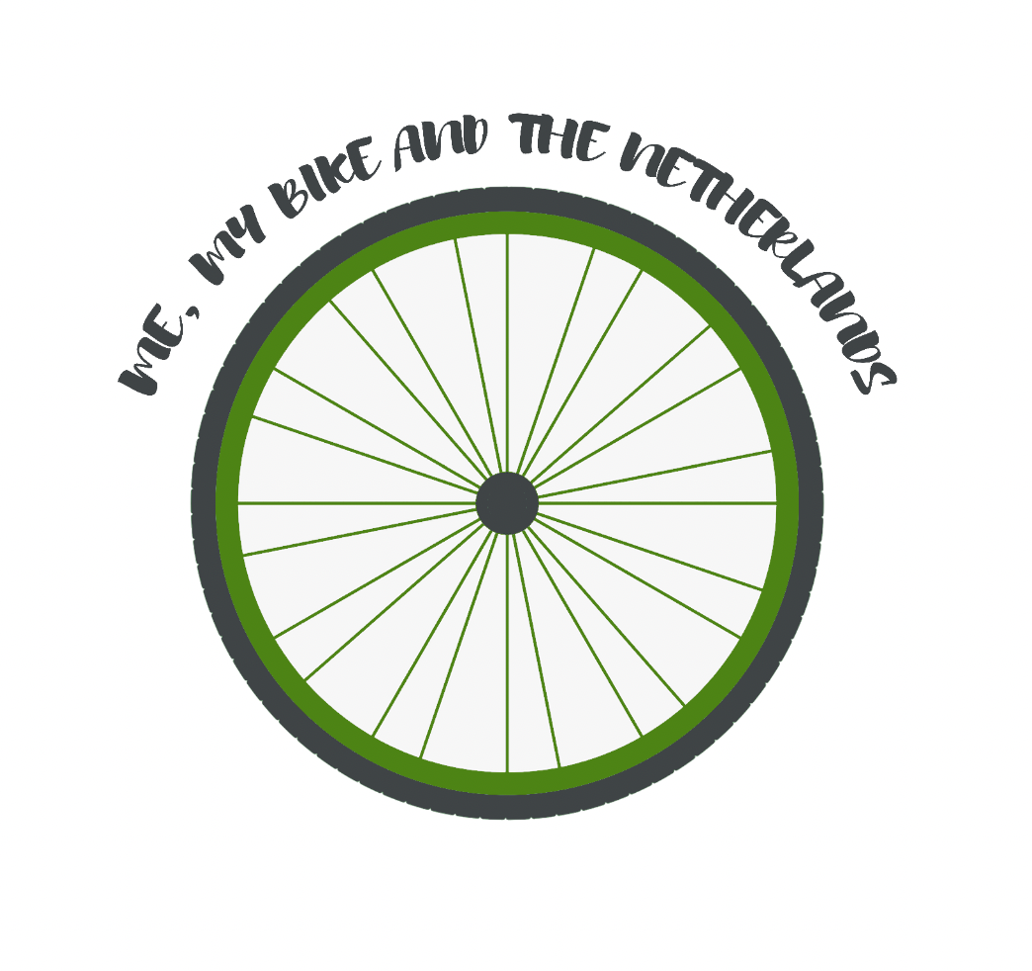
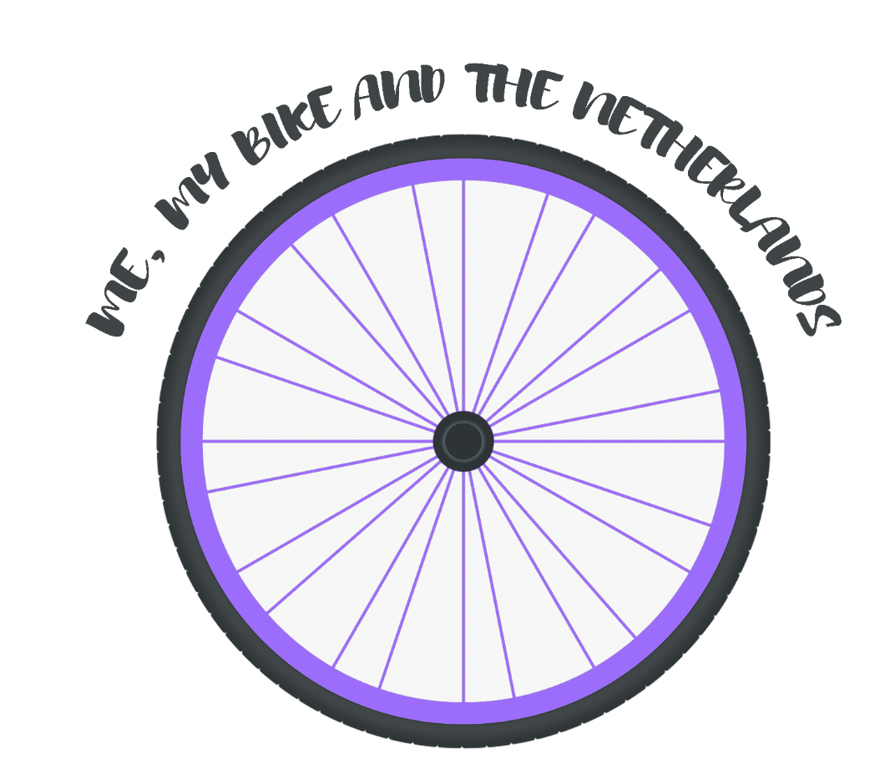
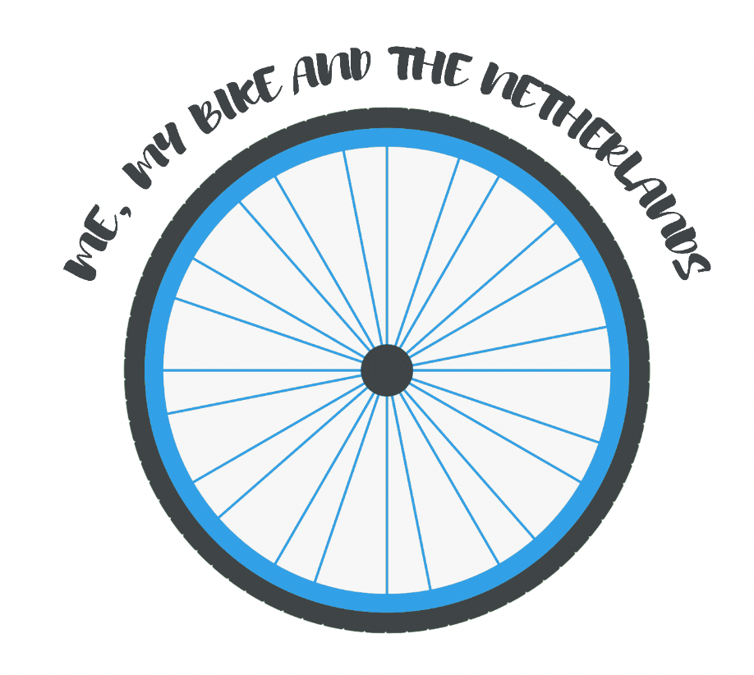
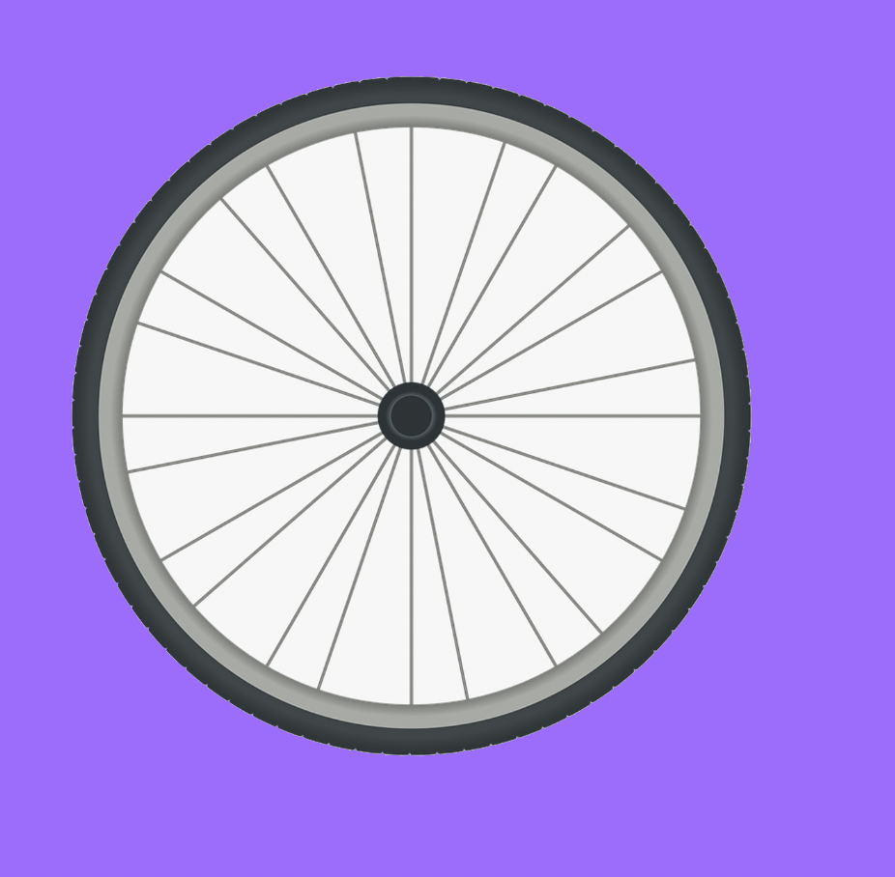
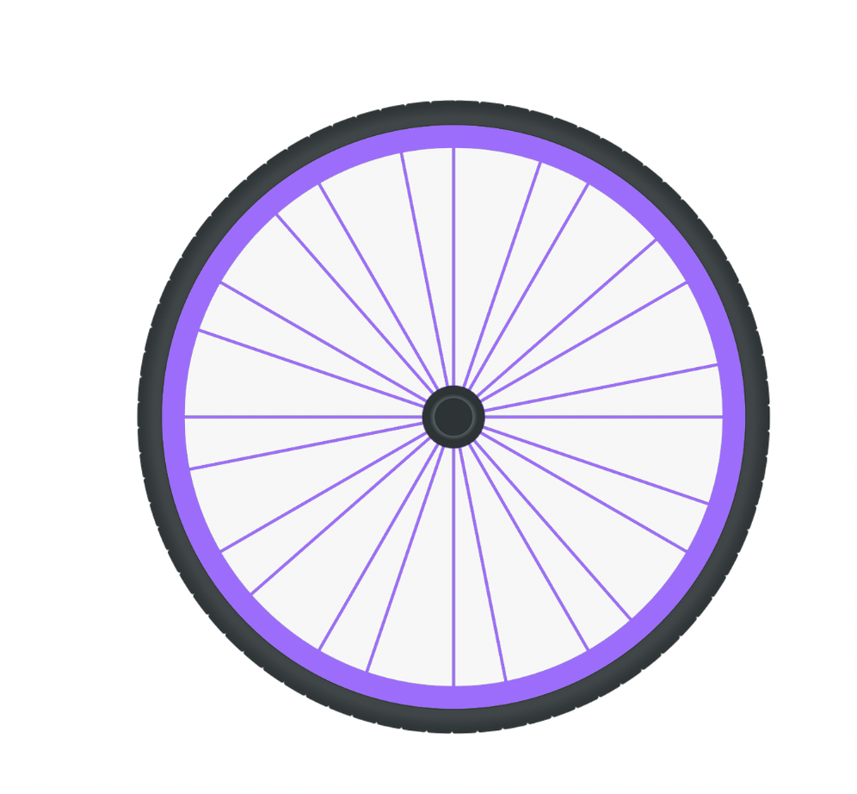
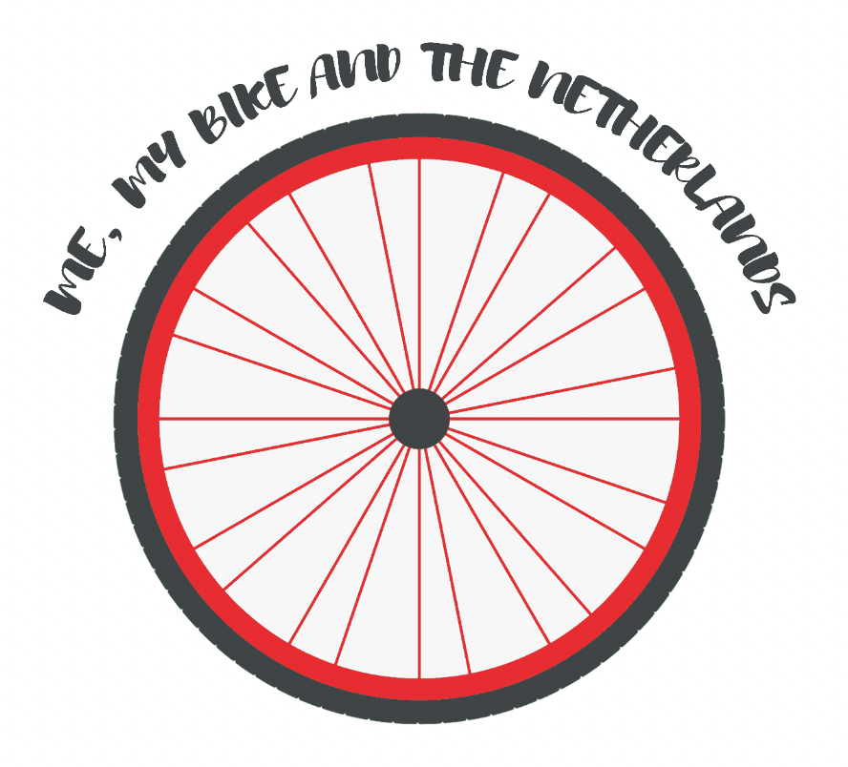
EXPERIMENTATION – BRANDING/LOGO
For the first part of my branding process I wanted to design a logo. This will be used for my website, poster and also possibly for in my documentary. I used a bike wheel as my starting point as it was simple but still linked into the main theme of my documentary so it’s recognisable. The wheel looked too simple by itself and it wouldn’t be easy to recognise, so I added the colours of The Netherlands flag using the gradient bucket fill tool. Although this was a good idea when I actually did it it ended up looking cheap and bad. As the gradient didn’t look professional I tried with block colour fill and it was starting to look more like I needed. I then experimented with different colour palettes as I didn’t like the colours of the flag together. Using these new colours I also tried out putting the colour behind the wheel for the background this looked good but I feel would be hard to use as you usually need no backgrounds for logos. ROTATE IT
I then added text on top and used the arch effect so the text surrounds the wheel. I tried this with other colours too. I think out of all my experimentation I like the blue one best and so will use this for my website.

